Slide 1
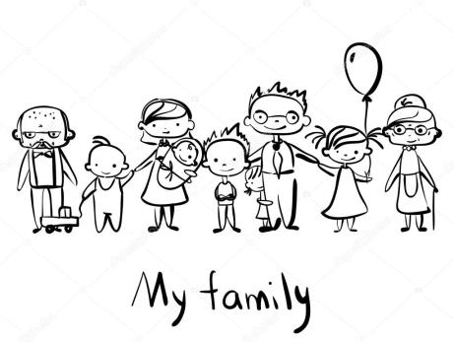
MEET MY FAMILY unit 4
1. del
Book page 58–75
Workbook page 54–71

Slide 2
Navodila za delo
Pripravi zvezek (notebook) za angleščino, delovni zvezek za angleščino (workbook) in učbenik za angleščino (book).
Označene imaš tudi strani. Če ti ne uspe vseh nalog rešiti, nič hudega, boš lahko dokončal/-a tudi naslednji teden. Poskusi pa narediti čim več.
Na nekaterih prosojnicah imaš znak . Klikni nanj in poslušaj posnetek. Posnetek lahko poslušaš večkrat.
Če boš imel/-a kje težave, nas prosi za pomoč (po elektronski pošti).
Na zadnjih prosojnicah so tudi rešitve delovnega zvezka. Preveri, ali si pravilno rešil/-a naloge v delovnem zvezku. Napačne poskusi popraviti.
Zdaj pa veselo na delo! ☺

Slide 3
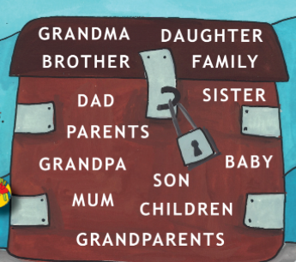
REVISION - ponovitev
Listen, look and point.
(Poslušaj, poglej in pokaži.)

Slide 4
ASK AND ANSWER! Vprašaj in odgovori.
REVISION - ponovitev
Whose horse is this?
This is granddaughter‘s horse .
Whose turtle is this?
This is Anna‘s turtle.
Whose car is this?
This is David‘s car.
Whose ship is this?
This is father‘s ship.
granddaugter
Anna
David
father

Slide 5
TWIG AND HOOKIE‘S FAMILY
BOOK – p. 64
Open your book at page 64, exercise 9. (Odpri učbenik na strani 64, naloga 9.)
Listen. Meet Twig and Hookie‘s family. (Poslušaj. Spoznaj Twigovo in Hookijevo družino.)
Try to read the conversation. (Poskusi prebrati pogovor.)

Slide 6
BOOK – p. 64

Slide 7
Read and guess the right numbers. (Preberi povedi in ugotovi pravilne številke.)
BOOK – p. 64, ex. 11
2
1
4
3

Slide 8
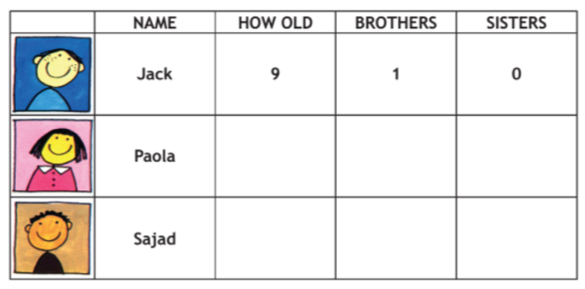
NOTEBOOK-zapis v zvezek
Listen and remember.
(Poslušaj in si zapomni.)
Write the sentences in your notebook. (Napiši slišane povedi v zvezek.)
Example (primer zapisa v zvezku):
Jack is nine. He has got one brother and no sisters.
Paola is ten. She has got two sisters and no brothers.
Sajad is six. He has got one brother and three sisters.
10 0 3
6 1 3

Slide 9
WORKBOOK – p. 66, ex. 19
Open your workbook at page 66.
(Odpri delovni zvezek na stani 66.)
Do the exercise 19.
(Reši nalogo 19.)

Slide 10
What is your mum like? What is dad like? Kakšna je tvoja mama? Kakšen je tvoj oče?
NICE - prijeten
GREAT – odličen
FRIENDLY - prijazen
FUSSY - izbirčen
LAZY - len
LOUD - glasen
HAPPY - vesel
DANGEROUS – nevaren

Slide 11
What is he like? What is she like?
NOTEBOOK-zapis v zvezek
NICE - prijeten
GREAT – odličen
FRIENDLY - prijazen
FUSSY - izbirčen
LAZY - len
LOUD - glasen
HAPPY - vesel
DANGEROUS – nevaren
My mum is nice.
I'm great.
My sister is friendly.
My grandpa is fussy.
My brother is lazy.
My dad is loud.
My parents are happy.
The snake is dangerous.

Slide 12
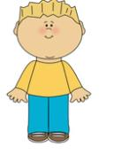
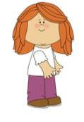
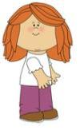
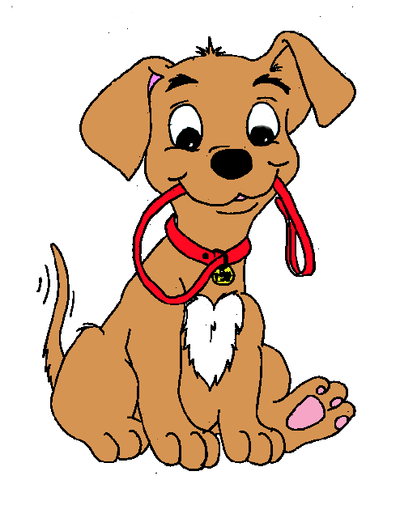
WORKBOOK – p. 63, 65
Open your workbook at page 63, 65.
(Odpri delovni zvezek na stani 63, 65.)
Do the exercises on pages 63 and 65.
(Reši naloge na strani 63 in 65.)
Remember? Se spomniš?
HE SHE IT THEY
HE is a boy. SHE is a girl. IT is a dog. THEY are friends.

Slide 13
Listen and role-play. (Poslušaj in zaigraj.)
BOOK – p. 68, ex. 16

Slide 14
WORKBOOK – p. 64, ex. 16
Open your workbook at page 64.
(Odpri delovni zvezek na stani 64.)
Do the exercise 16.
(Reši nalogo 16.)
Pri reševanju si lahko pomagaš tako, da še enkrat poslušaš posnetek na prejšnji strani projekcije.

Slide 15
Listen and tick. (Poslušaj posnetek in odkljukaj pravilno sliko.)
BOOK – p. 69, ex. 17

Slide 16
Listen to the story. Write down the numbers. Poslušaj zgodbo. Zapiši številke.
BOOK – p. 70, ex. 19
1
2
3
4
7
5
6
8
9

Slide 17
WORKBOOK – p. 66, ex. 20
Open your workbook at page 66.
(Odpri delovni zvezek na stani 66.)
Do the exercise 20.
(Reši nalogo 20.)
Pri reševanju si lahko pomagaš tako, da še enkrat poslušaš posnetek na prejšnji strani projekcije.

Slide 18
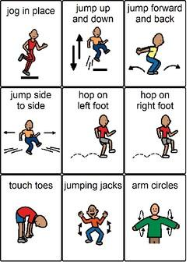
BREAK!!!

