Slide 1
MEET MY FAMILY unit 4
Book page 58–75
Workbook page 54–71

Slide 2
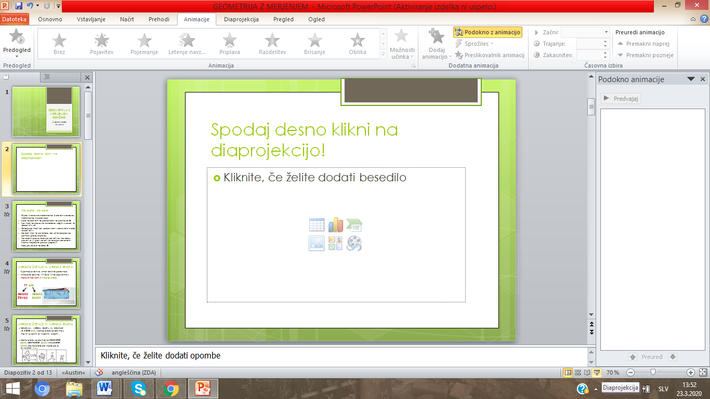
Spodaj desno klikni na diaprojekcijo! Nato klikaj z levo tipko na miški ali s puščico na tipkovnici.
TUKAJ!

Slide 3
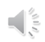
Navodila za delo
Pripravi zvezek (notebook) za angleščino, delovni zvezek za angleščino (workbook) in učbenik za angleščino (book).
Sledi navodilom na prosojnicah, ne prehitevaj ☺.
Kjer imaš zgoraj označeno book, notebook ali workbook, pripravi ustrezno gradivo za delo.
Označene imaš tudi strani. Če ti ne uspe vseh nalog rešiti, nič hudega, boš lahko dokončal/-a tudi naslednji teden. Poskusi pa narediti čim več.
Na nekaterih prosojnicah imaš znak . Klikni nanj in poslušaj posnetek.
Če boš imel/-a kje težave, nas prosi za pomoč (po elektronski pošti).
Na zadnjih prosojnicah so tudi rešitve delovnega zvezka. Preveri, ali si pravilno rešil/-a naloge v delovnem zvezku. Napačne poskusi popraviti.
Zdaj pa veselo na delo! ☺

Slide 4
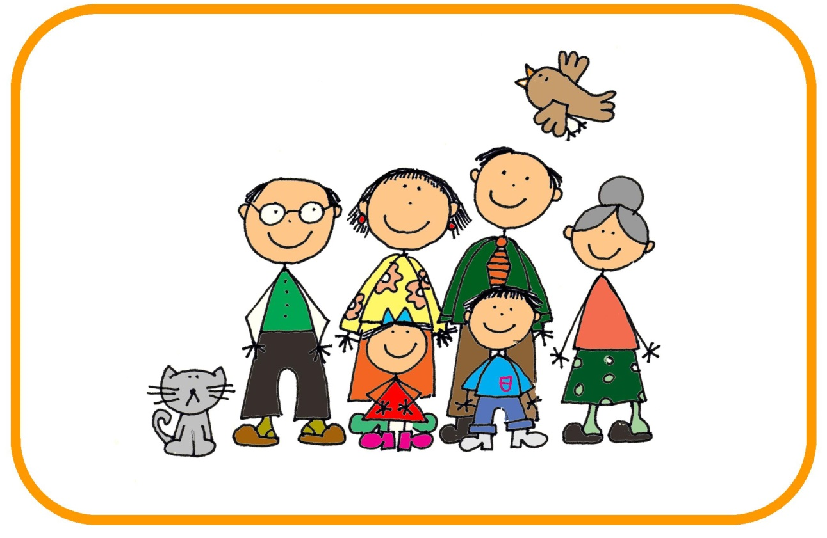
MEET MY FAMILY

Slide 5
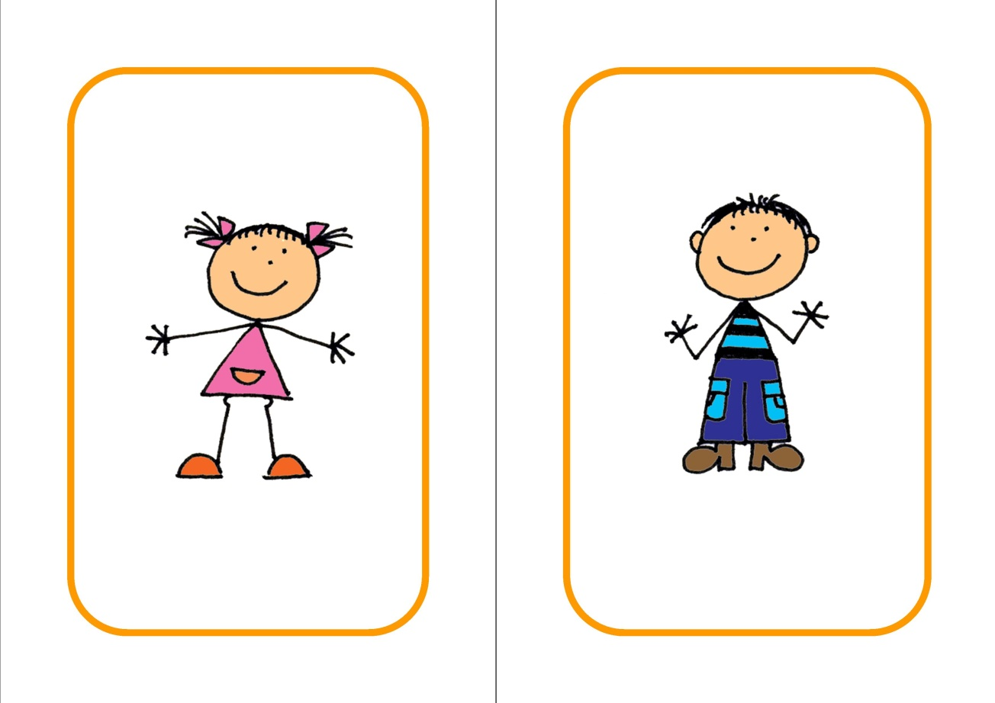
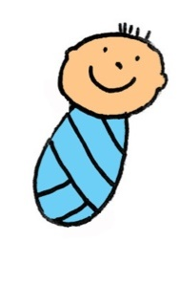
This is ME!
This is my BROTHER!
I am his SISTER!
This is our BABY!

Slide 6
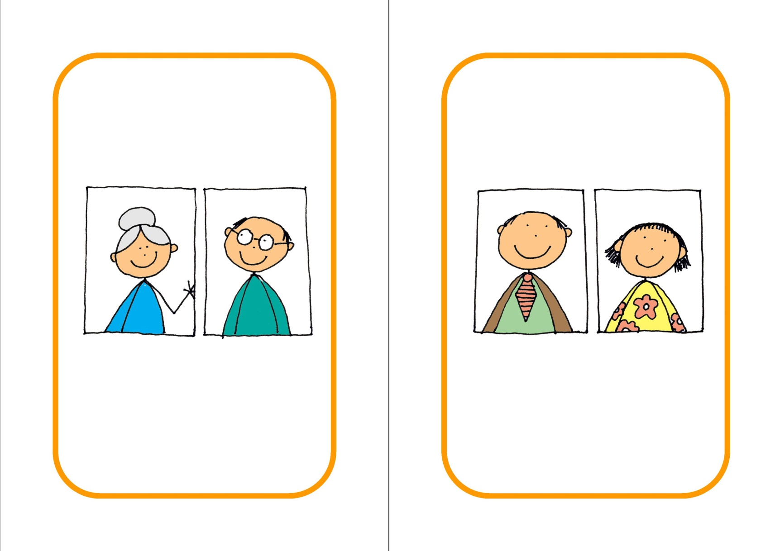
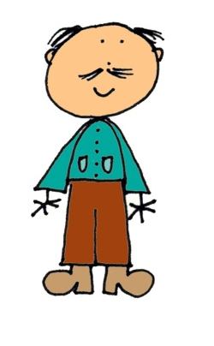

These are my GRANDPARENTS!
This is my GRANDPA!
This is my GRANDMA!

Slide 7
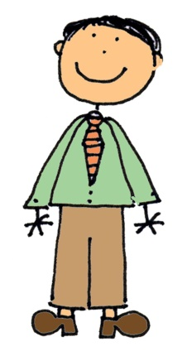

These are my PARENTS!
This is my FATHER!
This is my MOTHER!

Slide 8

These are my GRANDPARENTS!
These are my PARENTS!
We are their
GRANDCHILDREN!
We are their
CHILDREN!

Slide 9

These are my PARENTS!
He is their
SON!
I am their
DAUGHTER!

Slide 10

These are my GRANDPARENTS!
He is their
GRANDSON!
I am their
GRANDDAUGHTER!

Slide 11
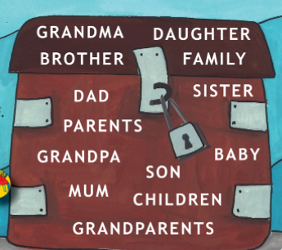

BOOK – p. 58
Open your book at page 58.
(Odpri učbenik na strani 58.)
Listen, look and point.
(Poslušaj, poglej in pokaži.)

Slide 12
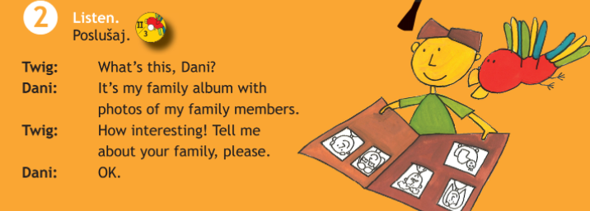
BOOK – p. 59
Open your book at page 59, exercise 2.
(Odpri učbenik na strani 58, naloga 2.)
Listen.

Slide 13

FAMILY MEMBERS družinski člani
NOTEBOOK
NAVODILO: PREVERI, ALI SI PREJŠNJI TEDEN PRAVILNO ZAPISAL VSE ANGLEŠKE BESEDE ZA DRUŽINSKE ČLANE.
Če tega še nisi naredil, naredi to sedaj.
PARENTS – starši
FATHER – DAD – oče
MOTHER – MUM – mama
SON – sin
DAUGHTER – hči
BABY – dojenček
SISTER – sestra
BROTHER – brat
GRANDPARENTS – stari starši
GRANDMA – babica
GRANDPA – dedek
GRANDDAUGHTER – vnukinja
GRANDSON – vnuk

Slide 14

WORKBOOK – p. 54, 55, 56
Open your workbook at page 54.
(Odpri delovni zvezek na stani 54.)
Do the exercises on pages 54, 55, 56.
(Reši naloge na straneh 54, 55, 56.)

Slide 15
Whose? Čigav?
Whose … is this? Čigav/-a/-o … je to?
Kadar želiš vprašati, čigavo je kaj, uporabiš vprašalnico WHOSE. Pri odgovoru poleg imena ali besede zapišeš ‘s.
Primer:
Whose book is this? Čigava knjiga je to?
This is Tina‘s book. To je Tinina knjiga.
Whose car is this? Čigav avto je to?
This is dad‘s car. To je očetov avto.
Da boš lažje razumel/-a si poglej spodnje posnetke. Ogledaš si jih tako, da nanje klikneš.
https://www.youtube.com/watch?v=HWr4NE87qSg
https://www.youtube.com/watch?v=uuuv0Lc3cXk
https://www.youtube.com/watch?v=TV3X26zXJNE

Slide 16



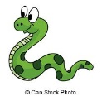
Whose? Čigav?
Whose … is this? Čigav/-a/-o … je to?
NOTEBOOK – prepiši v zvezek
Whose ball is this? This is Peter's ball.
Whose kite is this? This is Maja's kite.
Whose goldfish is this? It's my mum's goldfish.
Whose snake is this? It's my brother's snake.

Slide 17

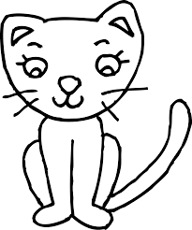
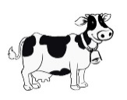
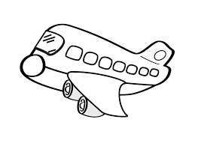
ASK AND ANSWER! Vprašaj in odgovori.
Whose dog is this?
This is Mary‘s dog.
Whose cat is this?
This is Jack‘s cat.
Whose cow is this?
This is farmer‘s cow.
Whose plane is this?
This is Tim‘s plane.
Mary
Jack
farmer
Tim

Slide 18
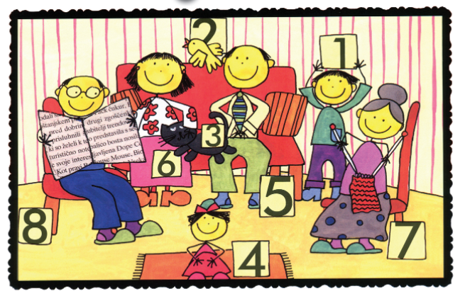
BOOK – p. 60
Look at the picture of Tim‘s family on page 60, exercise b. Say who‘s who.
(Glej sliko Timove družine in povej, kdo je kdo.)
Answers (rešitve):
Tim‘s grandpa is number 8.
Tim‘s mum is number 6.
Tim‘s dad is number 5.
Tim‘s sister is number 4.
Tim‘s cat is number 3.
Tim‘s bird is number 2.
Number 5 and 6 are Tim‘s parents.
Number 7 and 8 are Tim‘s grandparents.
And Tim is number 1.

Slide 19
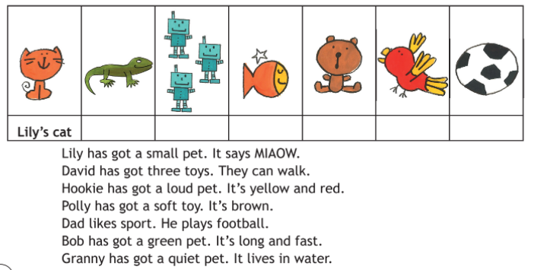
Whose are these animals and toys?
(Čigave so te živali in igrače?)
BOOK – p. 60
Look , read and answer. Page 60, exercise 4. (Poglej, preberi in odgovori. Stran 60, naloga 4.)
Bob‘s
David‘s
Granny‘s
Polly‘s
Hookie‘s
Dad‘s

Slide 20
WORKBOOK – p. 57, 58,59, 62
Open your workbook at page 57.
(Odpri delovni zvezek na stani 57.)
Do the exercises on pages 57, 58, 59.
(Reši naloge na straneh 57, 58, 59, 62.)

Slide 21
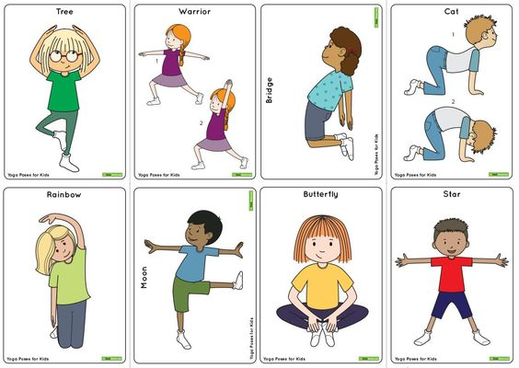
BREAK!!!

Slide 22
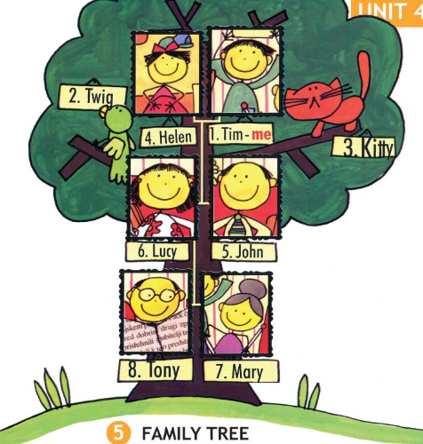
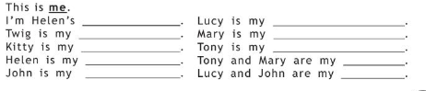
FAMILY TREE
BOOK – p. 61
Look and answer. Book, page 61, exercise 5.
(Poglej in odgovori. Učbenik, stran 61, naloga 5.)
This is me.
I am Helen‘s brother.
Twig is my bird.
Kitty is my cat.
Helen is my sister.
John is my father.
Lucy is my mother.
Mary is my grandmother.
Tony is my grandfather.
Tony and Mary are my grandparents.
Lucy and John are my parents.

Slide 23
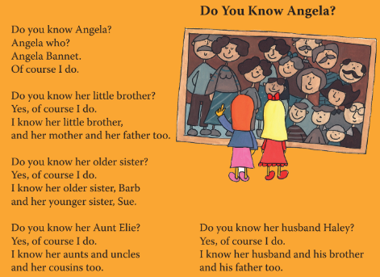
BOOK – p. 62
Listen and repeat. Book, page 62, exercise 6.
(Poslušaj in ponovi. Učbenik, stran 61, naloga 6.)

Slide 24
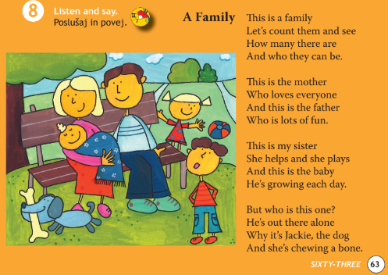
BOOK – p. 63
Listen and say. Book, page 63, exercise 8.
(Poslušaj in povej. Učbenik, stran 63, naloga 8.)

Slide 25
WORKBOOK – p. 60, 61
Open your workbook at page 60.
(Odpri delovni zvezek na stani 60.)
Do the exercises on pages 60, 61.
(Reši naloge na straneh 60, 61.)

Slide 26

Now check the answers in your workbook!

Slide 27
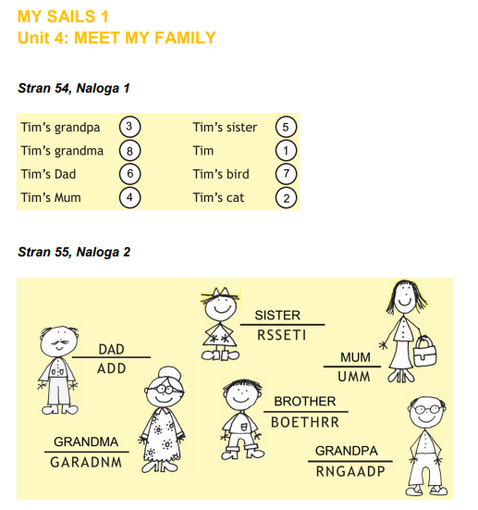
REŠITVE

Slide 28
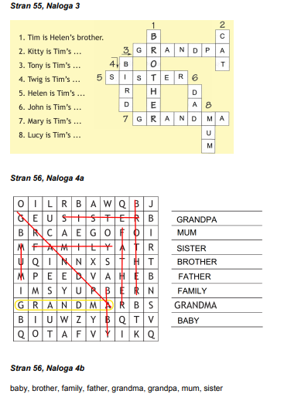
REŠITVE

Slide 29
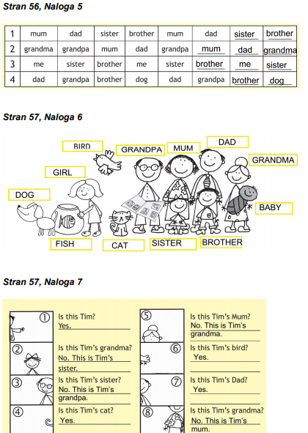
REŠITVE

Slide 30
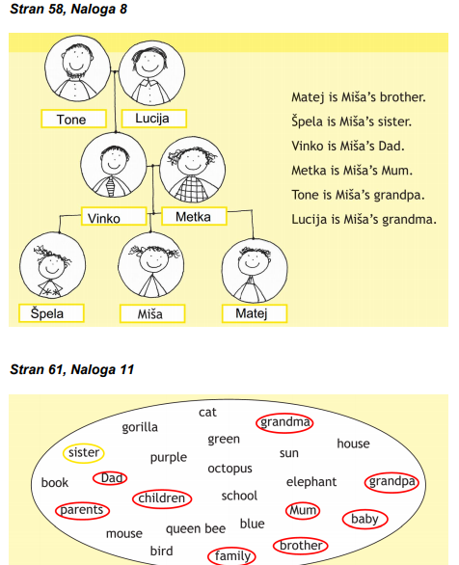
REŠITVE

Slide 31
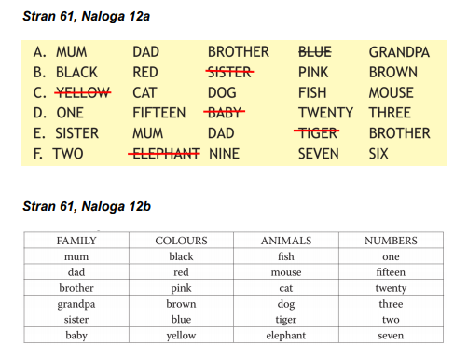
REŠITVE

Slide 32
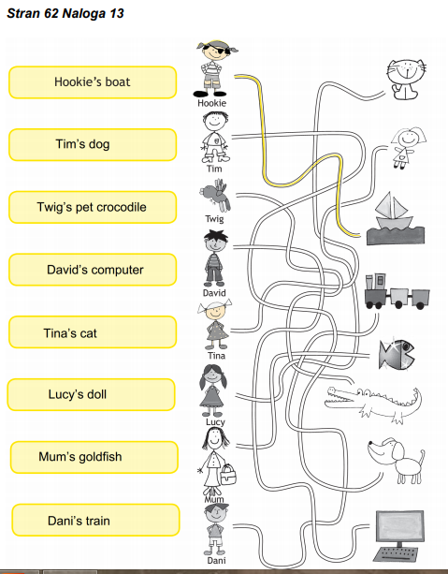
REŠITVE

