Slide 2
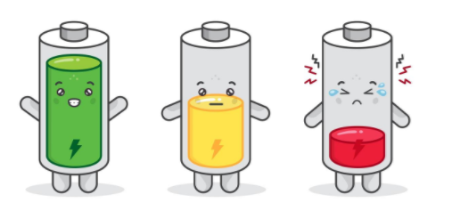
Drage učenke, dragi učenci! Srečno novo leto!
So tudi vam počitnice zeloooo hitro minile? Prepričani sva, da ste uživali in nabrali nove energije za leto 2021.
Za vas sva ponovno pripravili gradivo, in sicer bomo ponovili in nadaljevali bomo snov tretje enote (Toys). Naloge naredi v tem tednu.
V kolikor se ti kje pojavijo težave, nama piši.
Učiteljici Alja in Karmen

Slide 3
toys UNIT 3
Book: 48, 49, 50, 52
Workbook: 46–49, 52, 53

Slide 4
LET‘S REPEAT

Slide 5
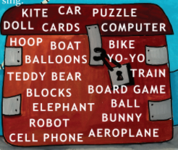
LISTEN AND REPEAT.
Poslušaj in ponovi.

Slide 6
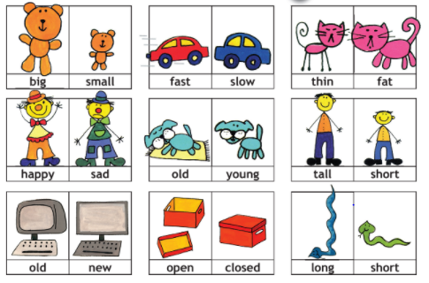
OPPOSITES
LISTEN AND REPEAT.
Poslušaj in ponovi.

Slide 7
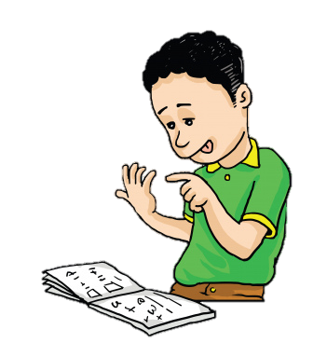
NUMBERS

Slide 8
BOOK – P. 48
LISTEN AND REPEAT.
Poslušaj in ponovi.

Slide 9
BOOK – P. 49
LISTEN AND CIRCLE THE CORRECT NUMBER.
Poslušaj in obkroži (zapiši) pravo število.
A
B
C
D
E
F
20
17
11
14
19
16

Slide 10
BOOK – P. 49
CHECK THE CORRECT NUMBERS.
Preveri prava števila.
A
B
C
D
E
F
20
17
11
14
19
16

Slide 11
NUMBERS 11–20
NOTEBOOK – ZAPIS V ZVEZEK
11 – ELEVEN
12 – TWELVE
13 – THIRTEEN
14 – FOURTEEN
15 – FIFTEEN
16 – SIXTEEN
17 – SEVENTEEN
18 – EIGHTEEN
19 – NINETEEN
20 – TWENTY

Slide 12
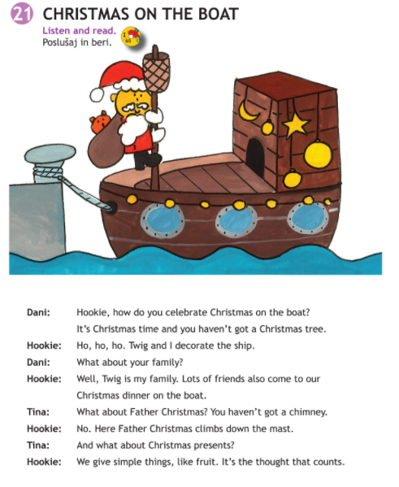
BOOK, P. 50
LISTEN AND READ.
(Poslušaj in preberi.)

Slide 13
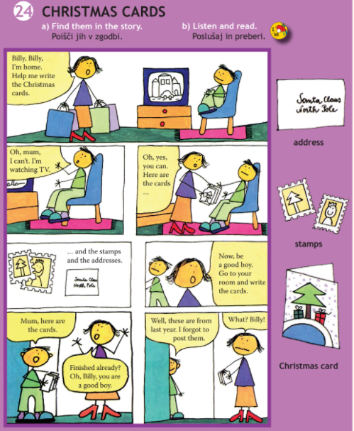
BOOK, P. 52
LISTEN AND READ.
(Poslušaj in preberi.)

Slide 14
OPEN YOUR WORKBOOK AND DO THE EXERCISES ON PAGES 46–49.
Odpri delovni zvezek in reši naloge od strani 46 do strani 49.

Slide 15
Now check the answers in your workbook!

Slide 16
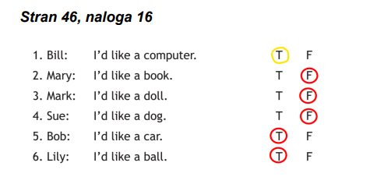
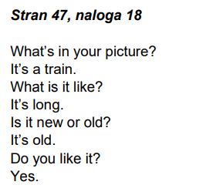
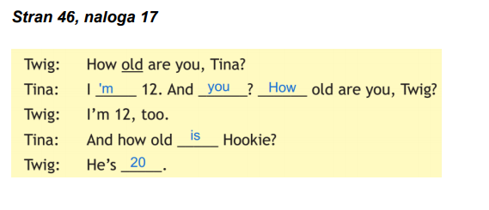

Slide 17
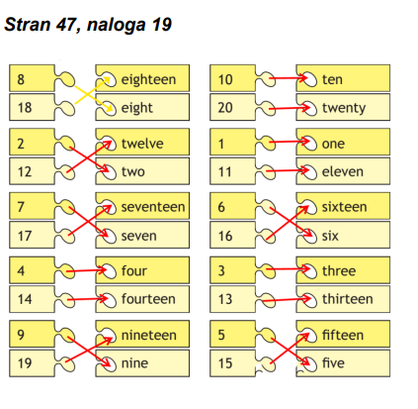

Slide 18
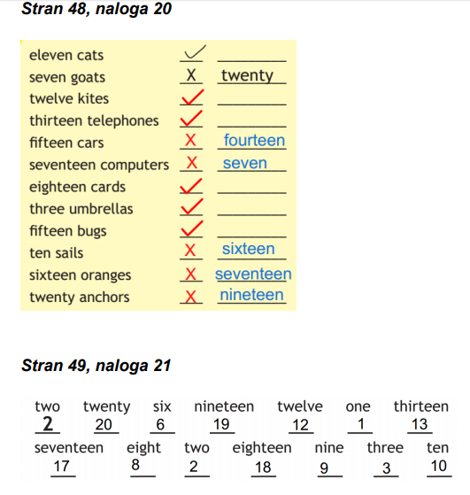

Slide 19
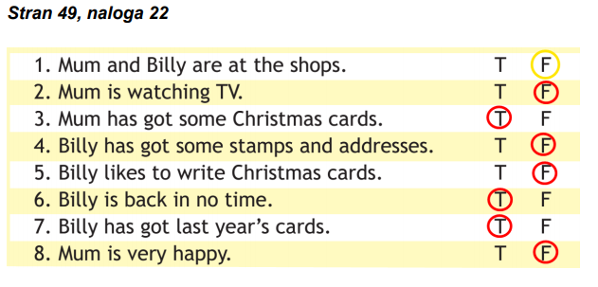

Slide 20
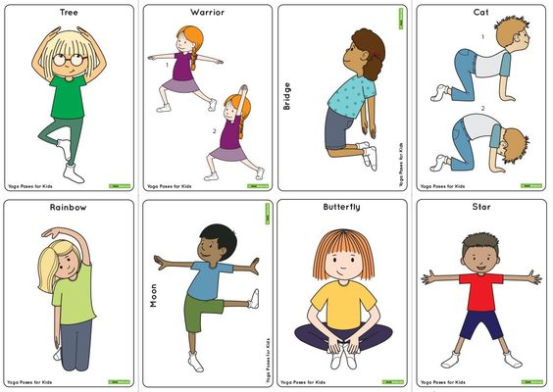
BREAK TIME!!!

Slide 21
OPEN YOUR WORKBOOK AND DO THE EXERCISES ON PAGES 52, 53.
Odpri delovni zvezek in reši naloge na strani 52 in strani 53.

Slide 22
Now check the answers in your workbook!

Slide 23
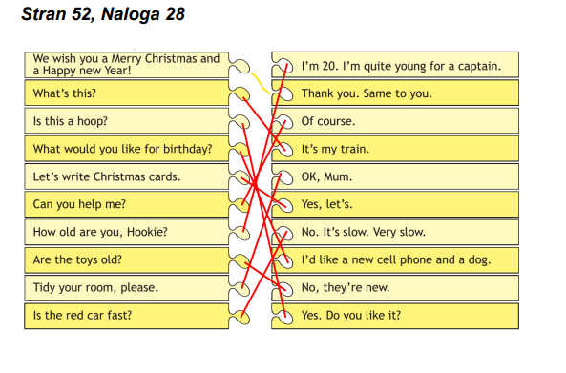

Slide 24
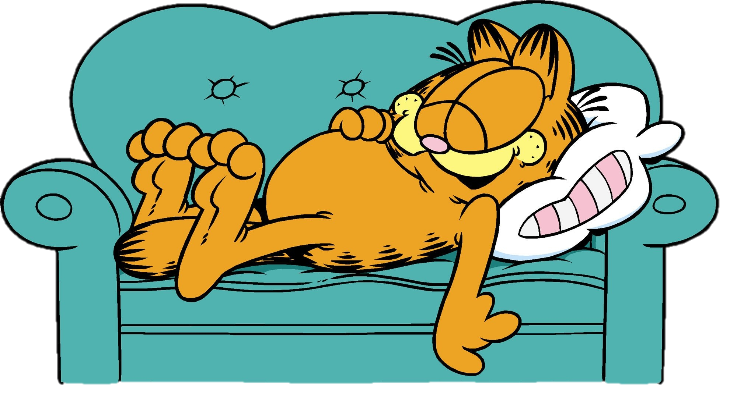
THAT IS ALL FOR THIS WEEK! .
HAVE A NICE DAY,
GOODBYE!

