Slide 1
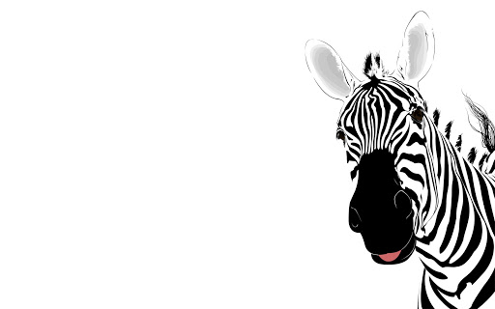
toys
UNIT 3
Book: 56, 57
Workbook: 36-53
NOTEBOOK

Slide 2
CHATTERBOX
BOOK, P. 56
NOTEBOOK
OPEN YOUR BOOK ON PAGE 56. Odpri knjigo na strani 56.
OPEN YOUR NOTEBOOK AND WRITE TITLE „CHATTERBOX“. Odpri zvezek in napiši naslov CHATTERBOX.
WRITE AND MATCH. Napiši in poveži.
Example (primer): A: What‘s this? B:It‘s a teddy bear.

Slide 3
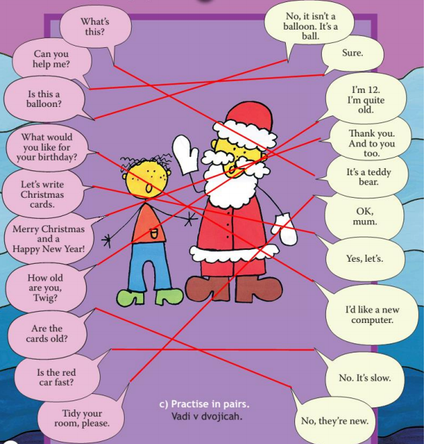
LISTEN AND CHECK YOUR NOTES.
Poslušaj in preveri zapiske.

Slide 4
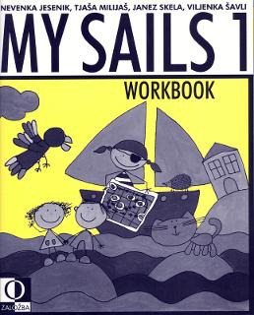
WORKBOOK: p. 36–53
CHECK, IF YOU HAVE SOLVED ALL THE TASKS IN THE WORKBOOK (FROM PAGE 36 TO PAGE 53). FILL IN THE MISSING TASKS.
Preveri, če imaš rešene vse naloge v delovnem zvezku (od stani 36 do strani 53).
Manjkajoče naloge dopolni.

Slide 5
REVISION – ponovitev
REPEAT UNIT 3 VOCABULARY (ponovi besedišče 3. enote):
TOYS (igrače),
NUMBERS (10–20) (števila),
OPPOSITES (nasprotja).
EVERYTHIG!!!
BOOK PAGE 57.
REPEAT, REPEAT, REPEAT …
WHAT? WHERE?

Slide 6
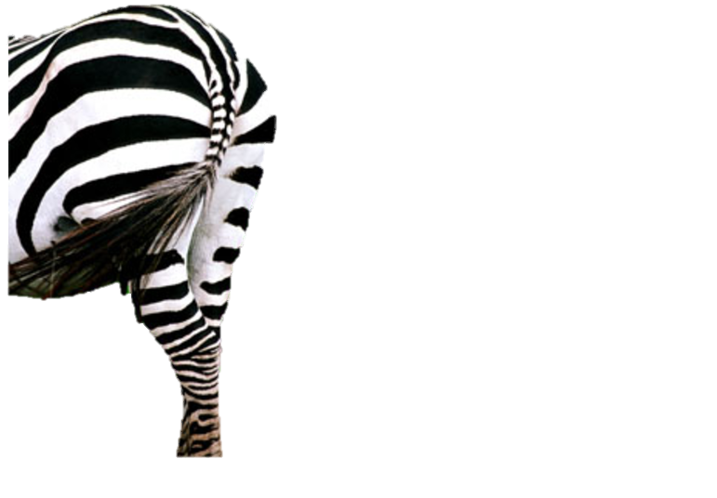
THAT IS ALL FOR THIS WEEK!
HAVE A NICE DAY,
GOODBYE!

