Slide 1
MEET MY FAMILY unit 4
Book page 58–60
Workbook page 54–57

Slide 2
This is ME!
This is my BROTHER!
I am his SISTER!
This is our BABY!

Slide 3
These are my GRANDPARENTS!
This is my GRANDPA!
This is my GRANDMA!

Slide 4
These are my PARENTS!
This is my FATHER!
This is my MOTHER!

Slide 5
These are my GRANDPARENTS!
These are my PARENTS!
We are their
GRANDCHILDREN!
We are their
CHILDREN!

Slide 6
These are my PARENTS!
He is their
SON!
I am their
DAUGHTER!

Slide 7
These are my GRANDPARENTS!
He is their
GRANDSON!
I am their
GRANDDAUGHTER!

Slide 8
BOOK – P. 58
OPEN YOUR BOOK AT PAGE 58.
(Odpri učbenik na strani 58.)
LISTEN, LOOK AND POINT.
(Poslušaj, poglej in pokaži.)

Slide 9
BOOK – P. 59
OPEN YOUR BOOK AT PAGE 59, EXERCISE 2.
(Odpri učbenik na strani 58, naloga 2.)
LISTEN.
(Poslušaj.)

Slide 10
FAMILY MEMBERS družinski člani
NOTEBOOK
NOTEBOOK – ZAPIS V ZVEZEK
PARENTS – starši
FATHER – DAD – oče
MOTHER – MUM – mama
SON – sin
DAUGHTER – hči
BABY – dojenček
SISTER – sestra
BROTHER – brat
GRANDPARENTS – stari starši
GRANDMA – babica
GRANDPA – dedek
GRANDDAUGHTER – vnukinja
GRANDSON – vnuk

Slide 11
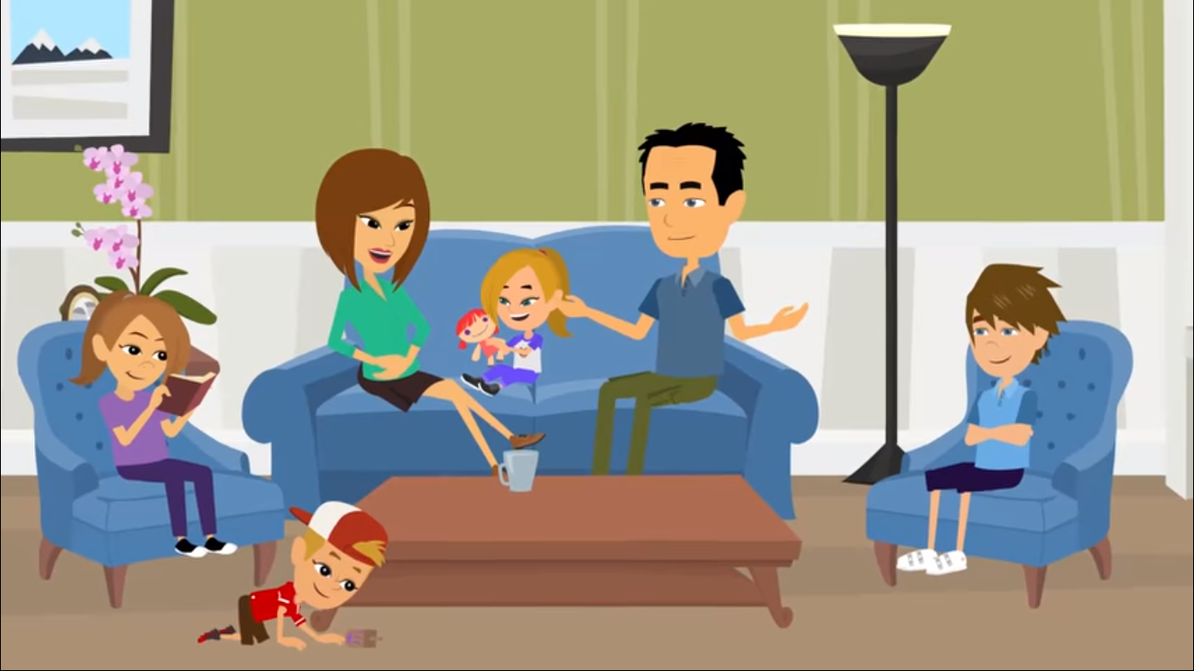
ABOUT MY FAMILY
WATCH. https://www.youtube.com/watch?v=lDZA54Bi8sg

Slide 12
WHOSE? Čigav?
WHOSE … IS THIS? Čigav/-a/-o … je to?
Kadar želiš vprašati, čigavo je kaj, uporabiš vprašalnico WHOSE. Pri odgovoru poleg imena ali besede zapišeš ‘s.
Whose book is this? Čigava knjiga je to?
This is Tina‘s book. To je Tinina knjiga.
Whose car is this? Čigav avto je to?
This is dad‘s car. To je očetov avto.
Da boš lažje razumel/-a si poglej spodnje posnetke. https://www.youtube.com/watch?v=HWr4NE87qSg
https://www.youtube.com/watch?v=uuuv0Lc3cXk
https://www.youtube.com/watch?v=TV3X26zXJNE

Slide 13
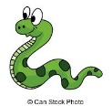
WHOSE? Čigav?
NOTEBOOK – prepiši v zvezek
Whose ball is this? This is Peter's ball.
Whose kite is this? This is Maja's kite.
Whose goldfish is this? It's my mum's goldfish.
Whose snake is this? It's my brother's snake.

Slide 14
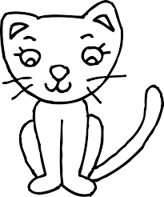
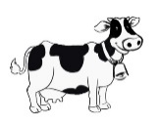
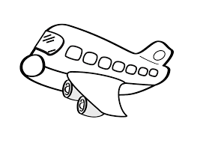
ASK AND ANSWER! Vprašaj in odgovori.
Whose dog is this?
This is Mary‘s dog.
Whose cat is this?
This is Jack‘s cat.
Whose cow is this?
This is farmer‘s cow.
Whose plane is this?
This is Tim‘s plane.
Mary
Jack
farmer
Tim

Slide 15
BOOK – p. 60
BOOK – P. 60, ex. b
LOOK AT THE PICTURE OF TIM‘S FAMILY ON PAGE 60, EXERCISE B. SAY WHO‘S WHO. (Glej sliko Timove družine in povej, kdo je kdo.)
Answers (rešitve):
Tim‘s grandpa is number 8.
Tim‘s mum is number 6.
Tim‘s dad is number 5.
Tim‘s sister is number 4.
Tim‘s cat is number 3.
Tim‘s bird is number 2.
Number 5 and 6 are Tim‘s parents.
Number 7 and 8 are Tim‘s grandparents.
And Tim is number 1.

Slide 16
WHOSE ARE THESE ANIMALS AND TOYS? (Čigave so te živali in igrače?)
BOOK – p. 60
BOOK – P. 60, ex. 4
Bob‘s
David‘s
Granny‘s
Polly‘s
Hookie‘s
Dad‘s

Slide 17
WORKBOOK – p. 54, 55, 56
WORKBOOK – P. 54, 55, 56, 57.
DO THE EXERCISES ON PAGES 54, 55, 56, 57.
(Reši naloge na straneh 54, 55, 56, 57.)

Slide 18
Now check the answers in your workbook!

Slide 19
REŠITVE

Slide 20
REŠITVE

Slide 21
REŠITVE

Slide 22
THAT IS ALL FOR THIS WEEK!
HAVE A NICE DAY,
GOODBYE!

