Slide 1
HELLO, HELLO! IT‘S ENGLISH TIME AGAIN!
UNIT 2
BOOK p. 38
WORKBOOK p. 36, 38
NOTEBOOK

Slide 2
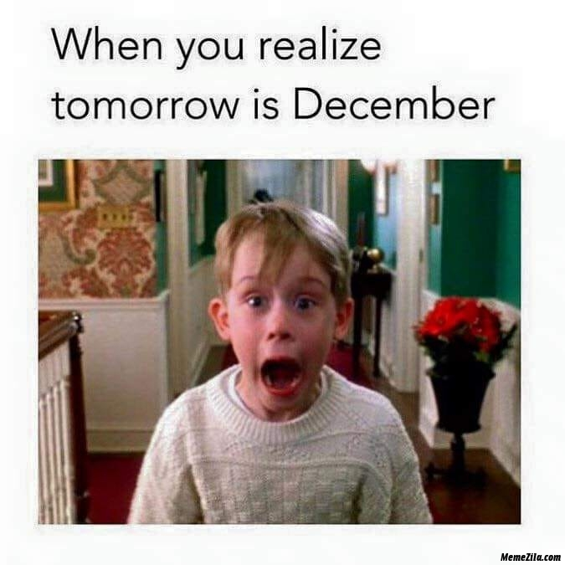
IT IS TIME FOR …
Ko ugotoviš, da je jutri december!
Je čas za …

Slide 3
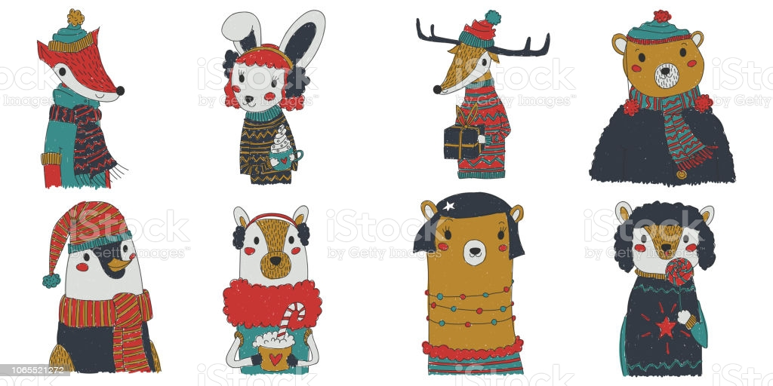
FESTIVE ANIMALS!
PRAZNIČNE ŽIVALI!

Slide 4
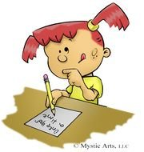
LET‘S REPEAT … PONOVIMO …
https://www.youtube.com/watch?v=8SfKfstRfPI
HOW CAN I SPELL MY NAME?
KAKO LAHKO ČRKUJEM SVOJE IME?

Slide 5
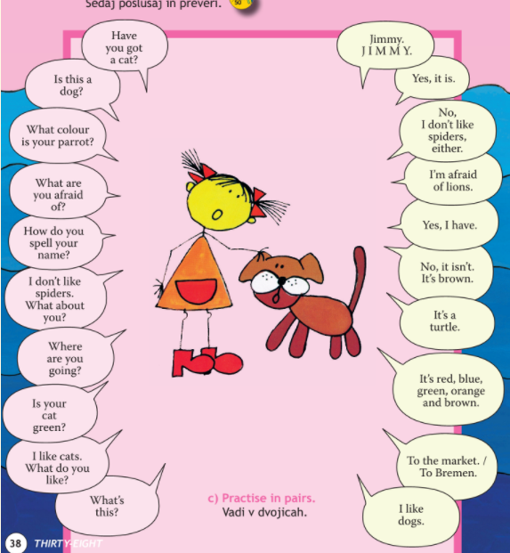
CHATTERBOX
BOOK – P. 38
OPEN YOUR BOOK ON PAGE 38. Odpri knjigo na strani 38.
OPEN YOUR NOTEBOOK AND WRITE TITLE „CHATTERBOX“. Odpri zvezek in napiši naslov CHATTERBOX.
WRITE AND MATCH. Napiši in poveži. Example (primer): A: Have you got a cat? B: Yes, I have.

Slide 6
CHATTERBOX
NOTEBOOK
primer zapisa v zvezku
A: Have you got a cat?
B: Yes, I have.
A: Is this a dog?
B: Yes, it is.
A: What colour is your parrot?
B: It‘s red, blue, green, orange and brown.
A: What are you afraid of?
B: I‘m afraid of lions.
A: How do you spell your name?
B: Jimmy. J I M M Y.
A: I don‘t like spiders. What about you?
B: No, I don‘t like spiders either.
A: Where are you going?
B: To the market./ To Bremen.
A: Is your cat green?
B: No, it isn‘t. It is brown.
A: I like cats. What do you like?
B: I like dogs.
A: What‘s this?
B: It‘s a turtle.

Slide 7
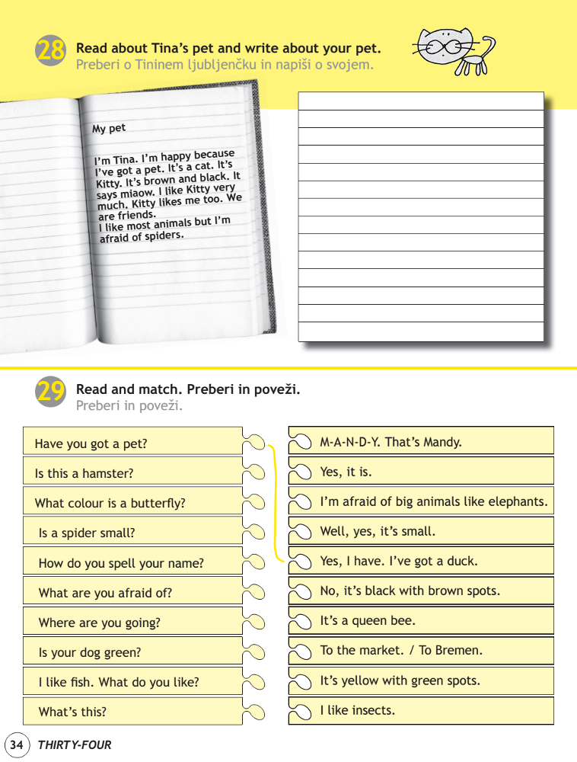
WORKBOOK p. 34, 35
OPEN YOUR WORKBOOK ON PAGES 34, 35. DO THE EXERCISES.
Odpri delovni zvezek na straneh 34.35 Reši naloge
Posebej se potrudi pri zapisu (naloga 28), saj bo lahko podobna naloga tudi v testu. Če hišnega ljubljenčka nimaš, si ga lahko izmisliš.

Slide 8
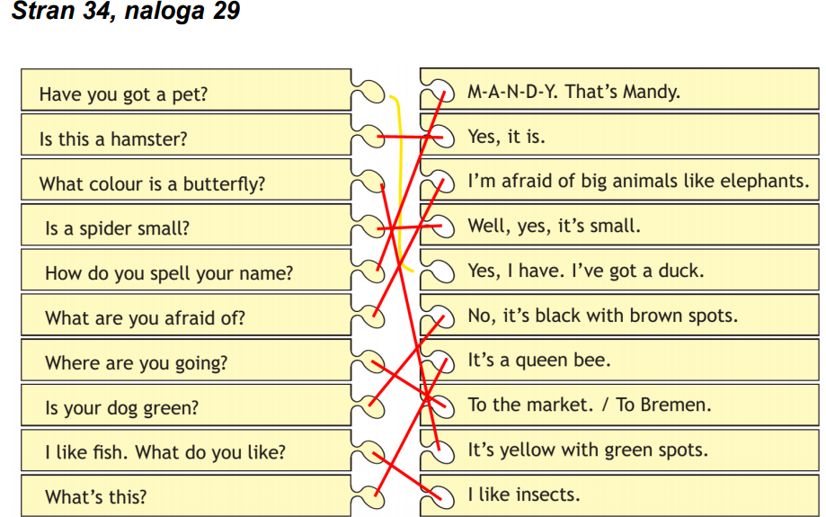
CHECK THE ANSWERS.
Preveri rešitve.

Slide 10
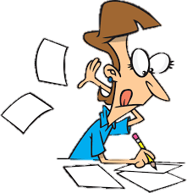
PREVERJANJE ZNANJA
V naslednjem tednu bova učiteljici za vas pripravili preverjanje znanja (ni za oceno). Naloge boste reševali preko spleta. Da boste pripravljeni, do 7. 12. ponovite:
števila (računi, more than, less than, zapis števil),
besedišče (živali, barve),
glagol imeti (have got, haven‘t got, has got, hasn‘t got),
glagol biti (I am, you/we/they are, he/she/it is),
like, don‘t like, afraid of,
kratek opis v povezavi z živalmi.
(npr. kdo si, katero domačo žival imaš, kakšna je …)
Primer opisa (DZ. Str. 34):
I‘m Lucy. I‘ve got a pet. It is a dog. Her name is Bjon and she is one year old. She is black. She has got four legs and big nose. She likes to eat meat. I like dogs, but I am afraid of snakes. I would like to have a cat.

Slide 11
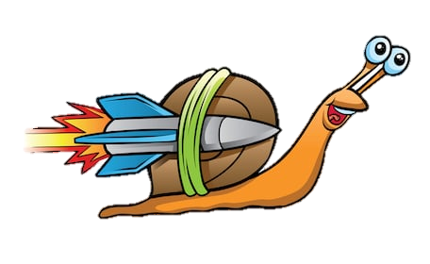
IF YOU WANT … ČE ŽELIŠ …
Si lahko pogledaš zgodbo Musicians of Bremen: https://www.youtube.com/watch?v=K5gr-A03RFM
Igraš igro na spletu – ANIMALS: https://www.gamestolearnenglish.com/spelling-bee/
Igraš igro na spletu – ANIMALS: https://www.eslgamesplus.com/learn-to-spell-names-of-farm-animals-esl-interactive-spelling-exercise-online/ (IGRAŠ TAKO, DA KLIKNEŠ NA DVE RUMENI ČRKI, KI JU ŽELIŠ ZAMENJATI MED SEBOJ)

Slide 12
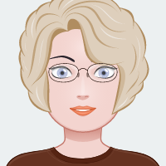
THAT IS ALL FOR THIS WEEK!
HAVE A NICE DAY, GOODBYE!

