Slide 1
HELLO, HELLO! IT‘S ENGLISH TIME.

Slide 2
Dragi/-a učenec/-ka!
Učiteljici sva pripravili gradivo, ki te bo popeljalo skozi uri angleščine v tem tednu.
Pripravi:
delovni zvezek (workbook),
knjigo (book),
zvezek (notebook).

Slide 3
Dobro beri navodila in pozorno poslušaj posnetke.
Zraven poskušaj tudi glasno ponavljati in izgovarjati angleške besede ter povedi.
Če se ti kje zatakne oziroma ti posnetki ne delujejo, za pomoč prosi svojo učiteljico angleščine.
alja.premoze@guest.arnes.si
karmen.mlinaric@guest.arnes.si

Slide 4
ANIMALS UNIT 2
BOOK p. 27–30
WORKBOOK p. 24–28
NOTEBOOK

Slide 5
HAVE GOT, HAS GOT (IMETI)
REVISION.
Ponovitev.
(+)
haven‘t got (-)
.
(+)
hasn‘t got (-)
(+) – trdilne povedi
(-) – nikalne povedi

Slide 6
HAVE GOT, HAS GOT (IMETI)
REVISION.
Ponovitev.
I HAVE GOT … = Jaz imam …
I HAVEN'T GOT … = Jaz nimam …
I have got a dog. = I've got a dog. (Jaz imam kužka.)
I haven't got a parrot. (Jaz nimam papige.)
WE/YOU/THEY HAVE GOT …
WE/YOU/THEY HAVEN‘T GOT …
We have got a bird. = We‘ve got a bird. (Mi imamo ptiča.)
We haven‘t got a crocodile. (Mi nimamo krokodila.)
You have got a butterfly. = You‘ve got a butterfly. (Ti imaš/Vi imate metulja.)
You haven‘t got a bug. (Ti nimaš/Vi nimate hrošča.)
They have got a hen. = They‘ve got a hen. (Oni imajo kokoš.)
They haven‘t got a lion. (Oni nimajo leva.)

Slide 7
HAVE GOT, HAS GOT (IMETI)
REVISION.
Ponovitev.
HE/SHE/IT HAS GOT … = On/Ona/Ono ima …
HE/SHE/IT HASN'T GOT … = On/Ona/Ono nima …
He has got a cat. = He's got a cat. (On ima mačko.)
He hasn't got a fish. (On nima ribe.)
She has got a hamster. = She's got a hamster. (Ona ima hrčka.)
She hasn't got a turtle. (Ona nima želve.)
Dog → It has got a tail. = It‘s got a tail. (Pes → Ono ima rep.)
It hasn‘t got wings. (Ono nima kril.)

Slide 8
COMPLETE SENTENCES. USE HAVE GOT/HAS GOT/HAVEN'T GOT/HASN'T GOT. WRITE ONLY THE ANSWERS INTO YOUR NOTEBOOK.
Dopolni povedi. Uporabi have got/has got/haven't got/hasn't got. V zvezek napiši samo rešitve. Ne prepisuj celotnih povedi.
1. Tina _____________ a monkey. (-)
2. Luke and Peter ____________ a new PC game. (+)
3. Hookie ______________ a boat. (+)
4. I ___________ a teddy bear. (+)
5. Children _________________ lots of toys. (+)
6. Dani __________ a pet crocodile. (-)
7. I _____________ a spider. (-)
8. You ____________ a lizard. (+)
9. We ______________ a nice family. (+)
10. A cat ______________ a tail. (+)
11. They _________________ a treasure. (-)
12. A snake _____________ legs. (-)

Slide 9
CHECK THE ANSWERS.
Preveri rešitve.
1. Tina hasn‘t got a monkey. (-)
2. Luke and Peter have got a new PC game. (+)
3. Hookie has got a boat. (+)
4. I have got a teddy bear. (+)
5. Children have got lots of toys. (+)
6. Dani hasn‘t got a pet crocodile. (-)
7. I haven‘t got a spider. (-)
8. You have got a lizard. (+)
9. We have got a nice family. (+)
10. A cat has got a tail. (+)
11. They haven‘t got a treasure. (-)
12. A snake hasn‘t got legs. (-)

Slide 10
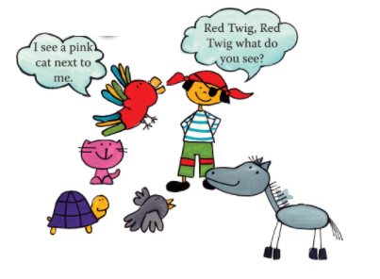
BOOK – P. 27
LISTEN AND REPEAT.
Poslušaj in ponovi.

Slide 11
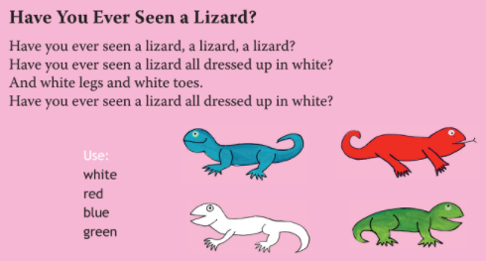
BOOK – P. 27
LISTEN AND SING.
Poslušaj in zapoj.

Slide 12
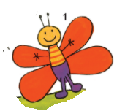
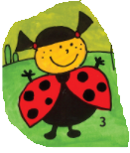
BOOK – P. 28
MORE ANIMALS
SAY IT OUT LOUD.
Glasno izgovori.
A BUTTERFLY
A BUG
AN ANT
A SPIDER
A LADYBIRD
A FLY

Slide 13
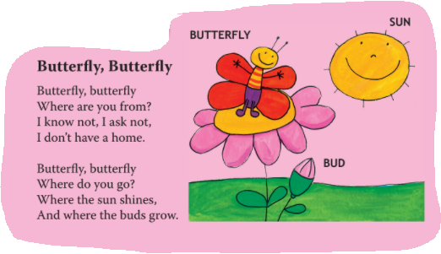
BOOK – P. 28
LISTEN AND REPEAT.
Poslušaj in ponovi.

Slide 14
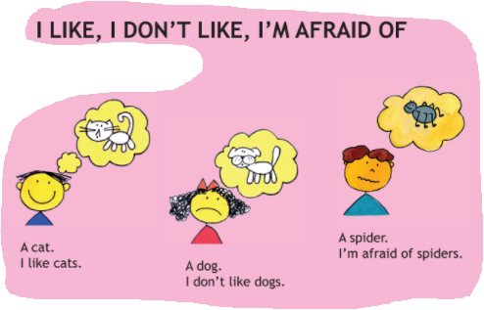
BOOK – P. 29
LISTEN AND REPEAT.
Poslušaj in ponovi.
I LIKE … = RAD/-A IMAM, VŠEČ MI JE …
I DON‘T LIKE … = NE MARAM, NI MI VŠEČ …
I‘M AFRAID OF … = BOJIM SE …

Slide 15
WRITE INTO YOUR NOTEBOOK.
Prepiši v zvezek.
I LIKE, I DON‘T LIKE, I‘M AFRAID OF
I LIKE … = RAD/-A IMAM, VŠEČ MI JE …
I DON‘T LIKE … = NE MARAM, NI MI VŠEČ …
I‘M AFRAID OF … = BOJIM SE …
I like birds.
I don‘t like bugs.
I‘m afraid of snakes.
What do you like? What don‘t you like? What are you afraid of?
Answer. Odgovori.
I like _______.
I don‘t like ________.
I‘m afraid of ________.

Slide 16
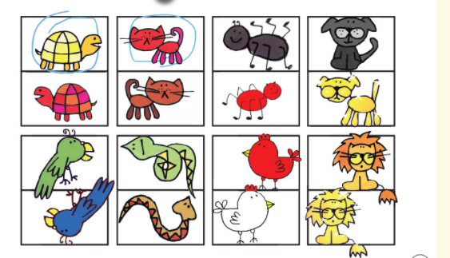
BOOK – P. 29
LISTEN AND WRITE WHAT YOU HEAR.
Poslušaj in zapiši, kar slišiš.

Slide 17
BOOK – P. 29
CHECK THE ANSWERS.
Preveri rešitve.
1. I like the yellow turtle.
2. I don‘t like the red cat.
3. I‘m afraid of the black spider.
4. I like the black dog.
5. I don‘t like the green parrot.
6. I like the green snake.
7. I‘m afraid of the white hen.
8. I like the gold lion.

Slide 18
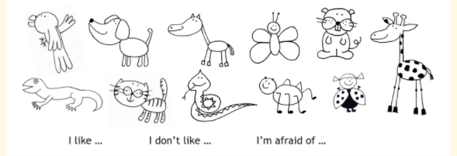
BOOK – P. 30
WHAT DO YOU THINK ABOUT ANIMALS? SAY IT OUT LOUD.
Kaj ti meniš o živalih? Povej na glas.

Slide 20
7-MINUTNA TELOVADBA 45 sekund telovadi, 15 sekund počivaj.
Skači gor in dol kot žaba.
Hodi z rokami in nogami po tleh kot medved.
V nizkem počepu hodi kot gorila.
Skači z rokami skupaj in narazen kot morska zvezda.
Teci na mestu hitro kot gepard.
Plazi se po tleh kot rak.
Korakaj na mestu kot slon.

Slide 21
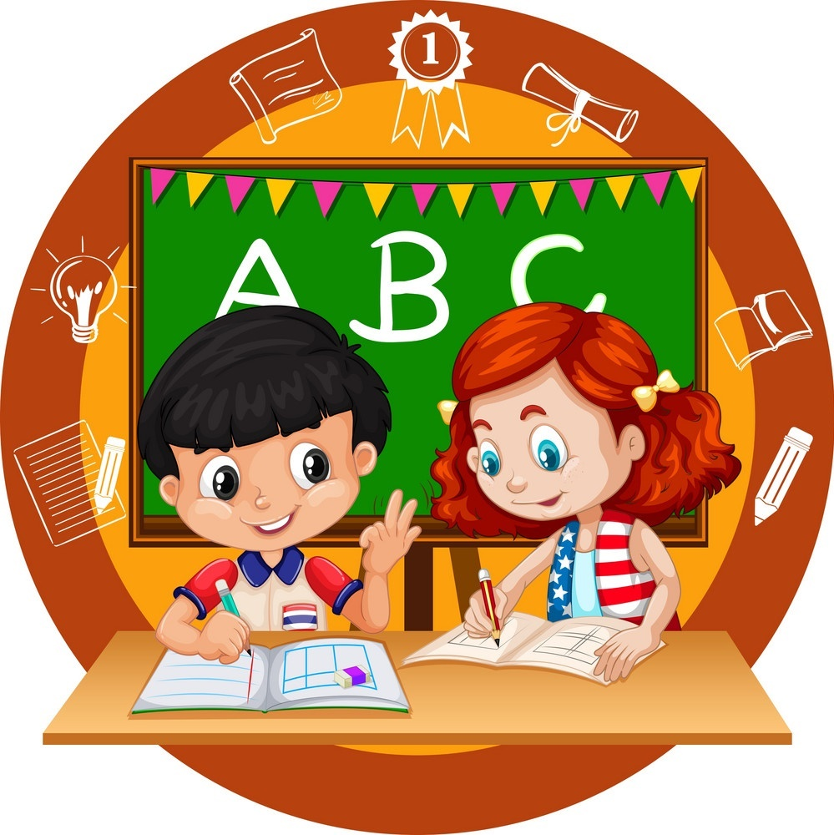
BACK TO WORK!

Slide 22
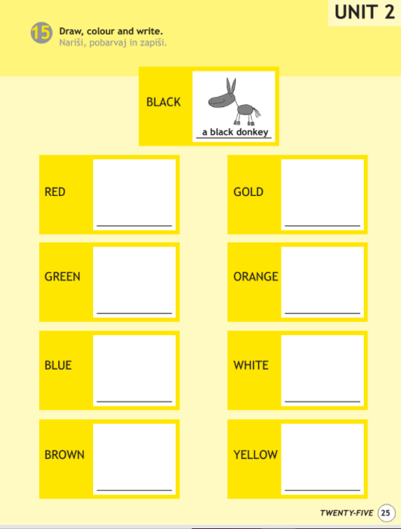
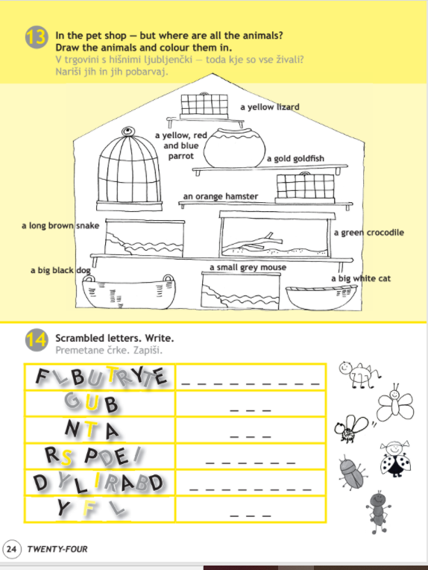
WORKBOOK – P. 24, 25
OPEN YOUR WORKBOOK ON PAGES 24 AND 25. DO THE EXERCISES.
Odpri delovni zvezek na straneh 24 in 25. Reši naloge.

Slide 23
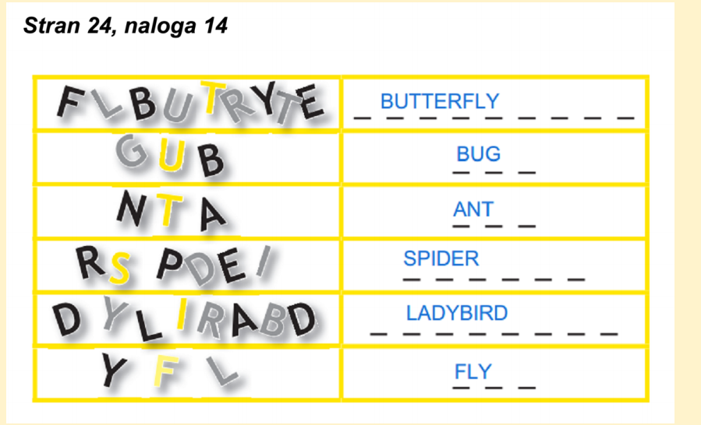
CHECK THE ANSWERS.
Preveri rešitve.

Slide 24
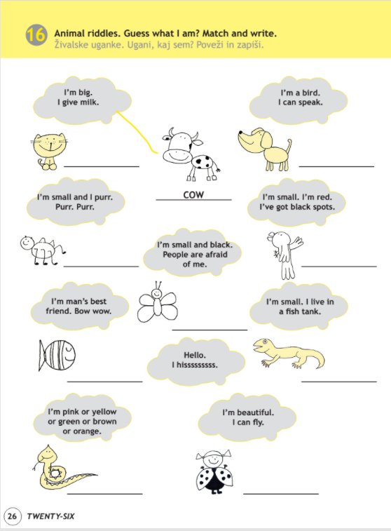
WORKBOOK – P. 26
OPEN YOUR WORKBOOK ON PAGE 26. DO THE EXERCISE.
Odpri delovni zvezek na strani 26. Reši nalogo.

Slide 25
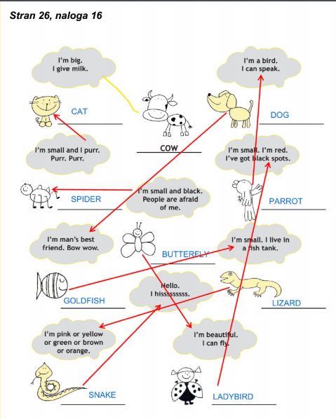
WORKBOOK – P. 26
CHECK THE ANSWERS.
Preveri rešitve.

Slide 26
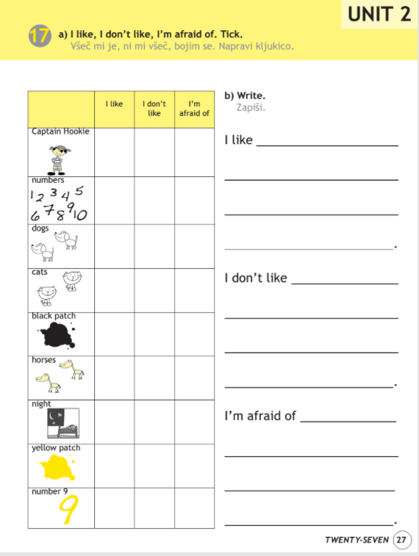
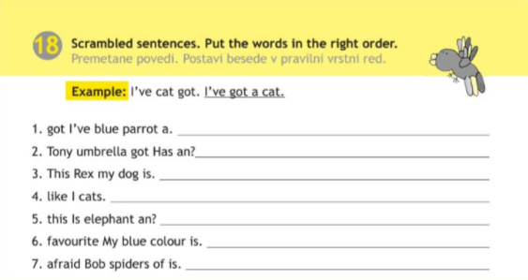
WORKBOOK – P. 27, 28
OPEN YOUR WORKBOOK ON PAGES 27 AND 28 (exercise 18). DO THE EXERCISES.
Odpri delovni zvezek na straneh 27 in 28 (naloga 18). Reši nalogi.

Slide 27
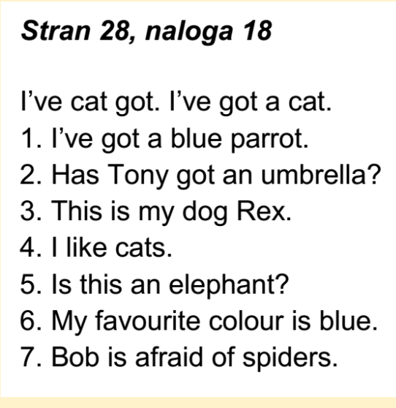
WORKBOOK – P. 28
CHECK THE ANSWERS.
Preveri rešitve.

Slide 28
WELL DONE! THAT IS ALL FOR THIS WEEK!
HAVE A NICE DAY, GOODBYE!

