Slide 1
HELLO, HELLO! IT‘S ENGLISH TIME.

Slide 2
Dragi učenec/-ka!
Za vas sva učiteljici pripravili gradivo, ki vas bo popeljalo skozi uri angleščine v tem tednu.
Pripravi:
delovni zvezek (workbook),
knjigo (book),
zvezek (notebook).

Slide 3
Dobro beri navodila in pozorno poslušaj posnetke (ne primikaj prehitro ☺).
Zraven poskušaj tudi glasno ponavljati in izgovarjati angleške besede ter povedi.
Če se ti kje zatakne, lahko za pomoč
prosiš svojo učiteljico.
alja.premoze@guest.arnes.si
karmen.mlinaric@guest.arnes.si

Slide 4
ANIMALS UNIT 2
BOOK p. 22–26
WORKBOOK p. 16–23
NOTEBOOK

Slide 5
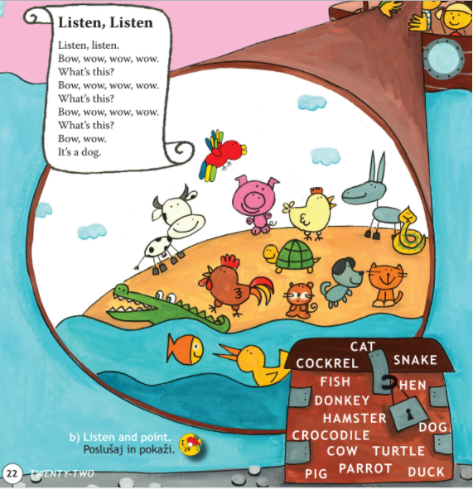
BOOK – P. 22
REVISION.
Ponovitev.
LISTEN, SAY AND POINT.
Poslušaj, izgovori in pokaži.

Slide 6
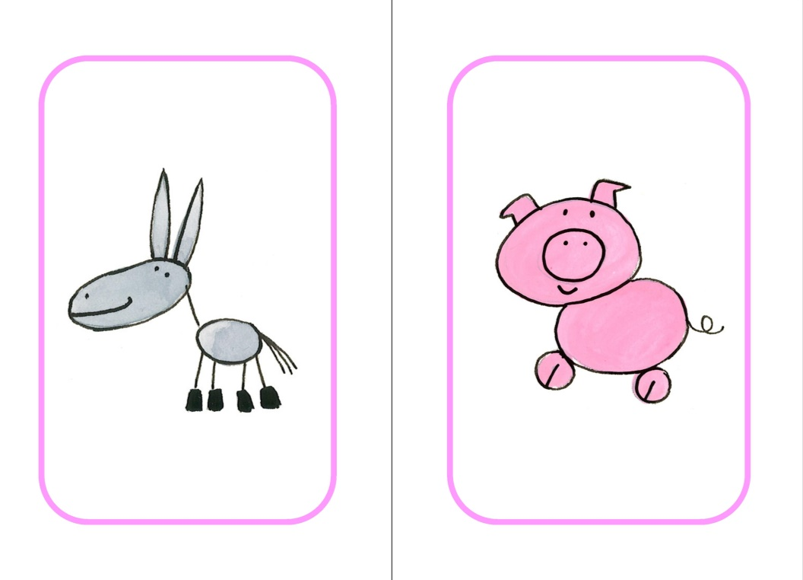
SAY.
Glasno izgovori.
A DOG
A CAT
A DONKEY
A PIG

Slide 7
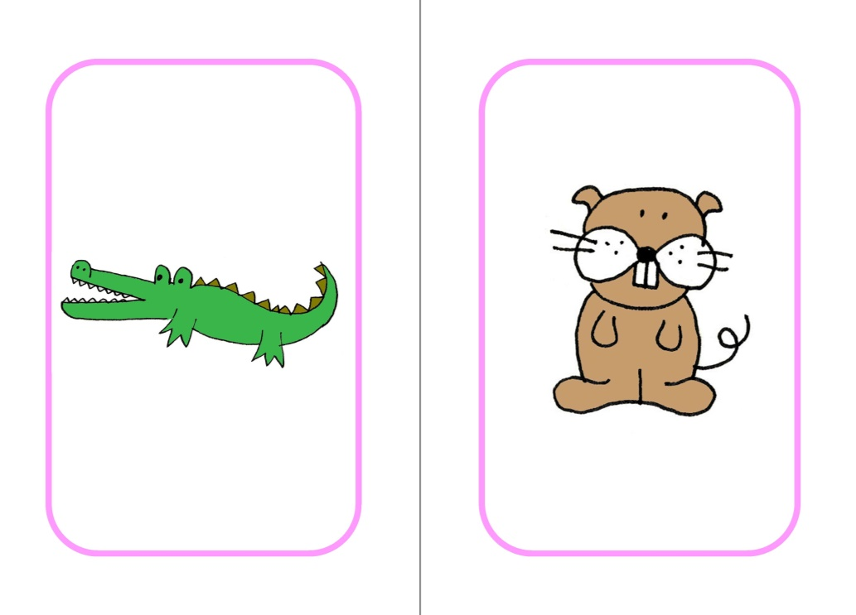
A TURTLE
A SNAKE
A CROCODILE
A HAMSTER

Slide 8
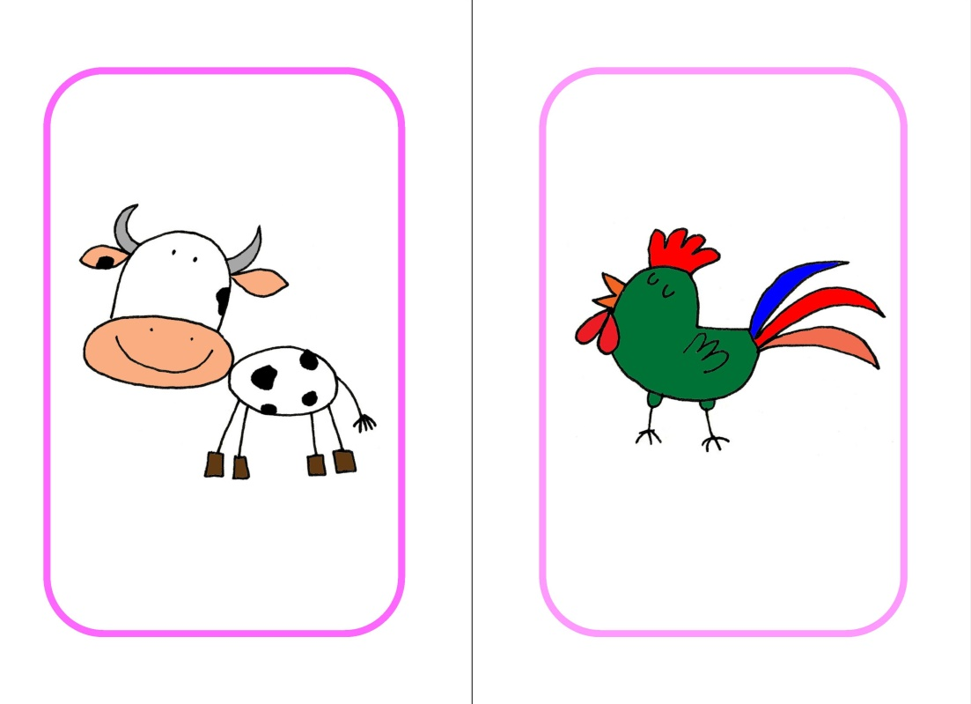
A MOUSE
A HORSE
A COW
A ROOSTER

Slide 9
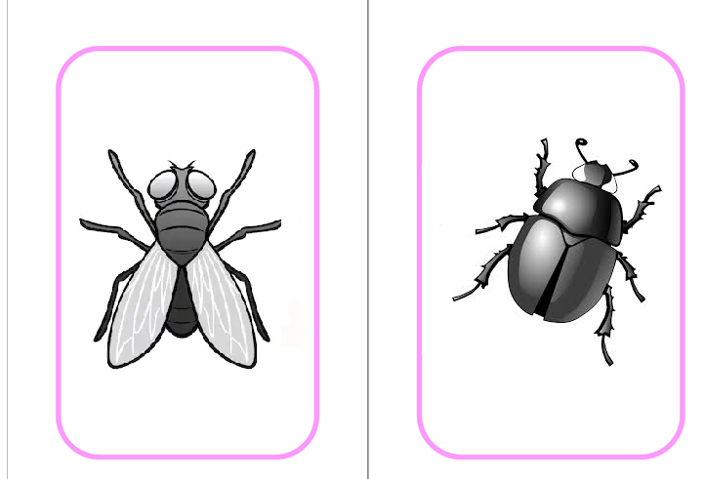
A LADYBIRD
AN ANT
A FLY
A BUG

Slide 10
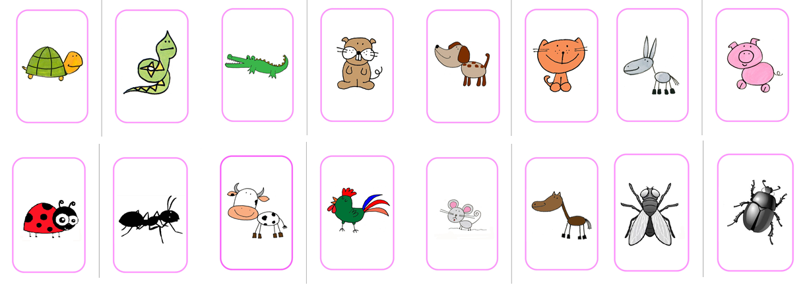
GUESS WHAT ANIMAL IS MISSING.
Ugani, katera žival manjka.

Slide 11
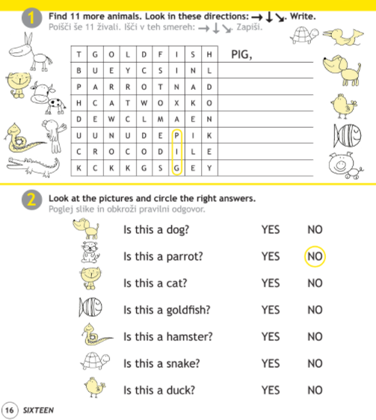
WORKBOOK – P. 16
OPEN YOUR WORKBOOK ON PAGE 16. DO THE EXERCISES.
Odpri delovni zvezek na stani 16. Reši nalogi.

Slide 12
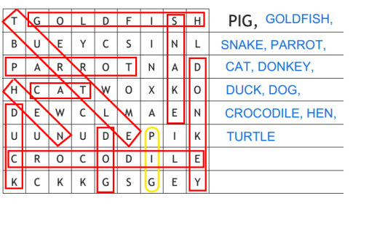
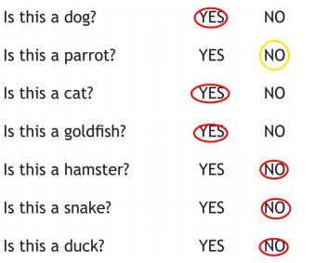
WORKBOOK – P. 16
CHECK THE ANSWERS.
Preveri odgovore.
Page 16, ex. 1 Page 16, ex. 2

Slide 13
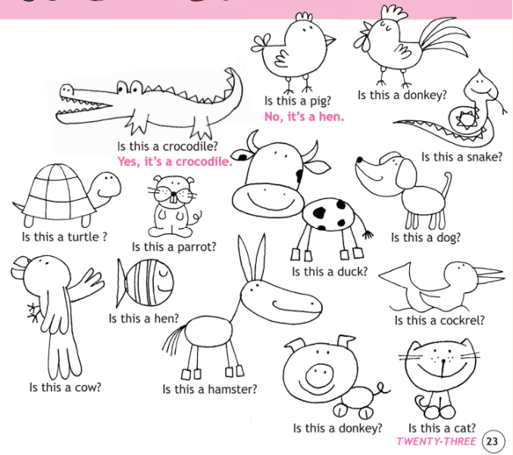
BOOK – P. 23
READ LOOK AND ANSWER.
Preberi, poglej in odgovori.
2. LISTEN AND CHECK.
Poslušaj in preveri.

Slide 14
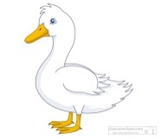
ASK AND ANSWER. Vprašaj in odgovori.
Is this a bug? No, it is a fly.
Is this an octopus? Yes, it is an octopus.
Is this __ _________? Yes, ________________.
Is this __ _________? No, _____________.
Is this ___ _________? Yes, __________________.
Is this __ _________? No, __________________.
Is this __ _________? Yes, _____________.
Is this __ _________? No, _______________.
a rooster
a dog
an elephant
a hippo
a duck
a horse
it is a rooster
it is an ant
it is an elephant
it is a crocodile
it is a duck
it is a donkey

Slide 15
NOTEBOOK
WRITE QUESTIONS AND ANSWERS INTO YOUR NOTEBOOK. Napiši vprašanja in odgovore v zvezek.
ANIMALS

Slide 16
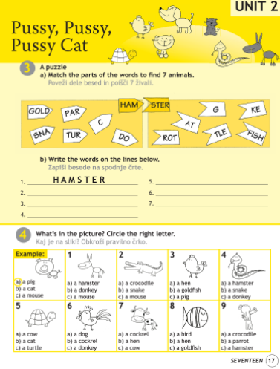
WORKBOOK – P. 17
OPEN YOUR WORKBOOK ON PAGE 17. DO THE EXERCISES.
Odpri delovni zvezek na stani 17. Reši nalogi.

Slide 17
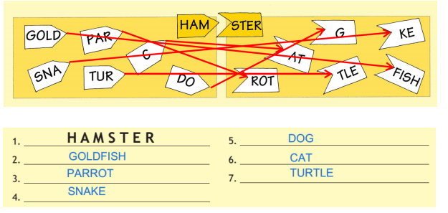
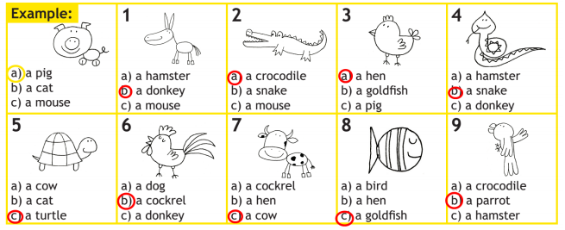
WORKBOOK – P. 17
CHECK THE ANSWERS.
Preveri odgovore.
Page 17, ex. 3
Page 17, ex. 4

Slide 18
TIME TO TAKE A BREAK!

Slide 19
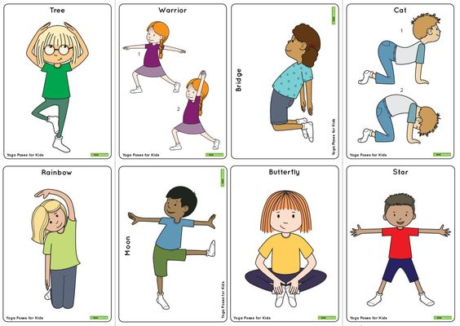
BREAK!!!!

Slide 21
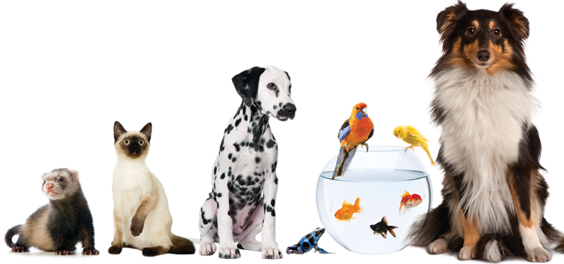
PETS DOMAČE ŽIVALI
Do you have any pets?
How many?
What animal would you like to have as a pet?
Why?
1. Imaš domačo žival?
2. Koliko?
3. Katero žival bi rad imel za „domačo žival“?
4. Zakaj?

Slide 22
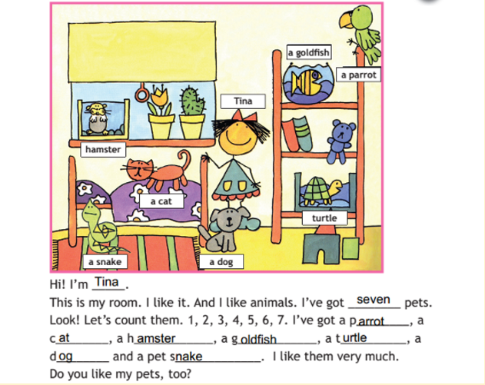
BOOK – P. 24, ex. 4
LISTEN AND COMPLETE THE TEXT. USE THE WORDS IN THE PICTURE.
Poslušaj in dopolni besedilo. Uporabi besede s slike.

Slide 23
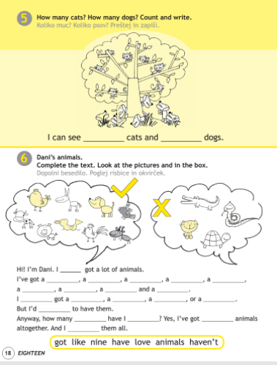
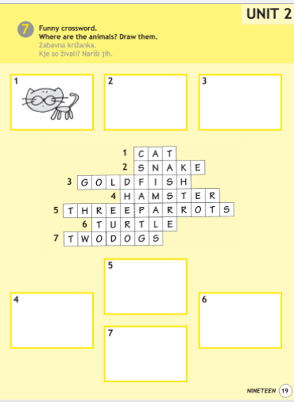
WORKBOOK – P. 18, 19
OPEN YOUR WORKBOOK ON PAGE 18 AND 19.
DO THE EXERCISES.
Odpri delovni zvezek na stani 18 in 19. Reši naloge.

Slide 24
WORKBOOK – P. 18, 19
CHECK THE ANSWERS.
Preveri odgovore.
Page 18, ex. 5
Page 19, ex. 6

Slide 25
BOOK – P. 24, ex. 5
LISTEN AND WRITE THE NUMBERS.
Poslušaj in zapiši številke.

Slide 26
BOOK – P. 24, ex. 5
NOTEBOOK
NOW CHECK THE NUMBERS AND WRITE 4 EXAMPLES IN YOUR NOTEBOOK.
Zdaj preveri številke in zapiši štiri primere (povedi) v zvezek.
Primer zapisa v zvezku
PETS
BOOK P. 24, EX. 5
Hello. I‘m Tilly. I have got a hamster.
My name is Marry. I have got a parrot.
I am Bob. I have got a pet snake.
She is Sue. She has got a cat.

Slide 27
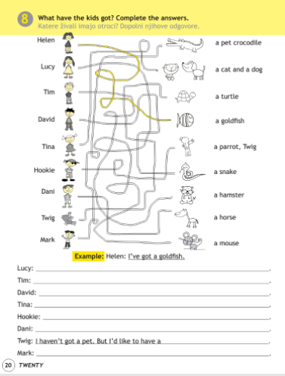
WORKBOOK – P. 20
OPEN YOUR WORKBOOK ON PAGE 20. DO THE EXERCISE.
Odpri delovni zvezek na stani 20. Reši nalogo.

Slide 28
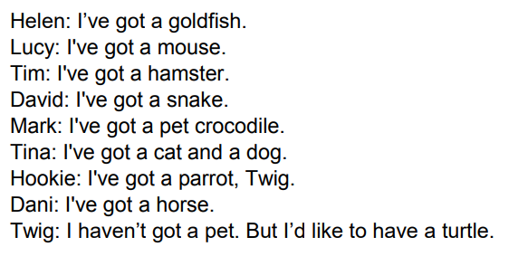
WORKBOOK – P. 20
CHECK THE ANSWERS.
Preveri odgovore.
Page 20

Slide 29
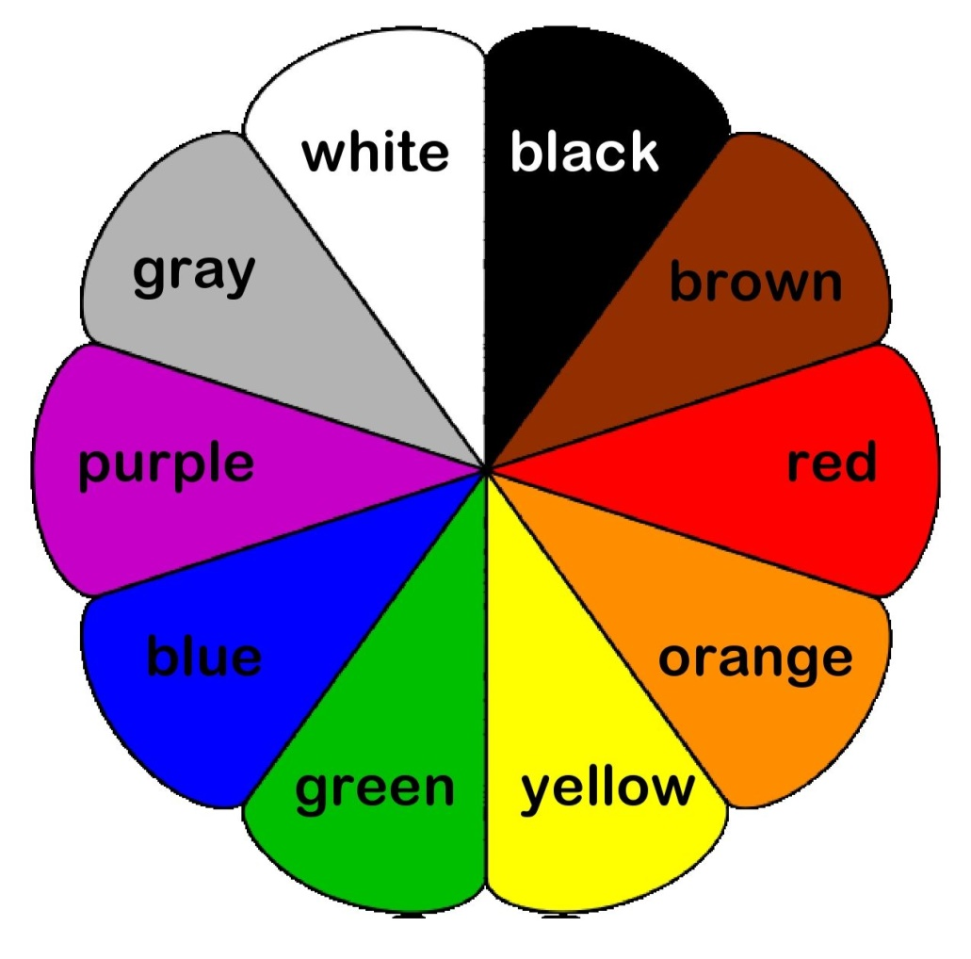
COLOURS
REPEAT AND SAY.
Ponovi in povej.

Slide 30
COLOURS
BOOK – P. 25, ex. 8
LISTEN, LOOK AND POINT.
Poslušaj, poglej in pokaži.

Slide 31
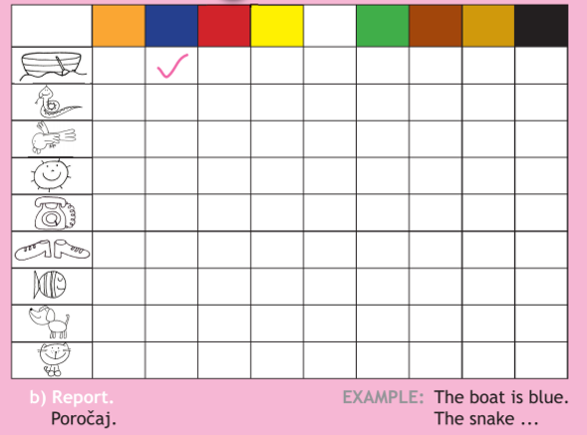
WHAT COLOUR IS IT?
BOOK – P. 26, ex. 9
LISTEN AND TICK.
Poslušaj in odkljukaj.

Slide 32
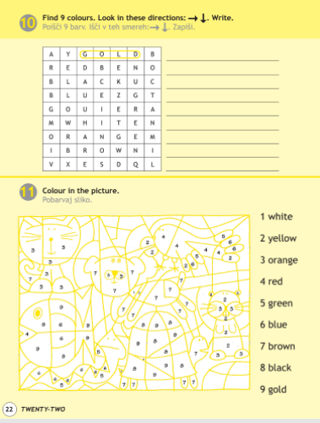
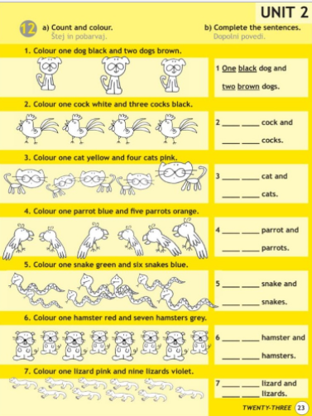
WORKBOOK – P. 22, 23
OPEN YOUR WORKBOOK ON PAGE 22, 23.
DO THE EXERCISE.
Odpri delovni zvezek na stani 22, 23. Reši naloge.

Slide 33
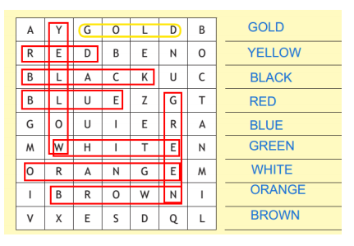
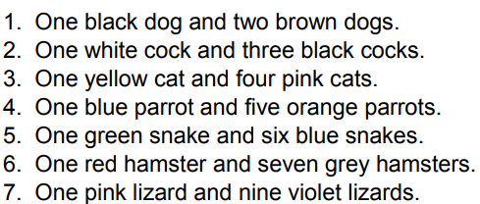
WORKBOOK – P. 22, 23
CHECK THE ANSWERS.
Preveri odgovore.
Page 22, ex. 5 Page 23, ex. 6

Slide 34
VERY GOOD! THAT IS ALL FOR THIS WEEK!
HAVE A NICE DAY, GOODBYE!

