Slide 1
HOME UNIT 5
BOOK p. 83, 84, 86
WORKBOOK p. 82, 83
WORKSHEET – singular, plural

Slide 2
SINGULAR AND PLURAL NOUNS Write into your notebook. Prepiši v zvezek.
NOTEBOOK
SINGULAR (ednina) | PLURAL (množina)
a cat | two cats
a girl | five girls
a mirror | three mirrors
a house | four houses
an elephant | six elephants
an apple | eleven apples
an umbrella | nine umbrellas

Slide 3
SINGULAR AND PLURAL NOUNS Remember. Zapomni si.
Besede (samostalniki) imajo v ednini spredaj a oziroma an.
Tiste besede, ki se začnejo na samoglasnik (a, e, i, o, u), imajo spredaj an. Vse ostale besede pa a.
V množini člena a in an pred besedo ni več. Dobijo pa besede na koncu končnico -s.
a chair
two chairs
three book
a books

Slide 4
SINGULAR AND PLURAL NOUNS Write into your notebook and match. Prepiši v zvezek in poveži.
BOOK – p. 83 + notebook

Slide 5
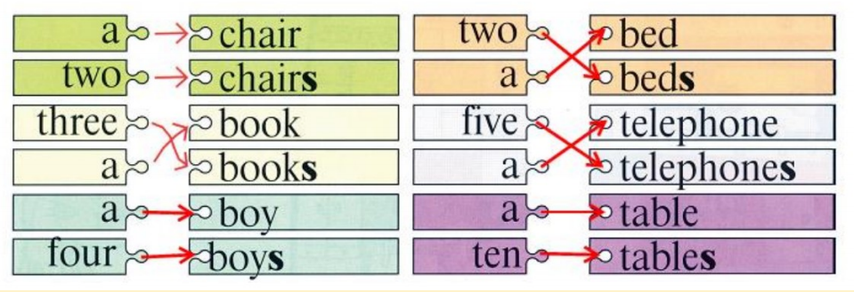
SINGULAR AND PLURAL NOUNS Check your answers. Preveri rešitve.
BOOK – p. 83 + notebook

Slide 6
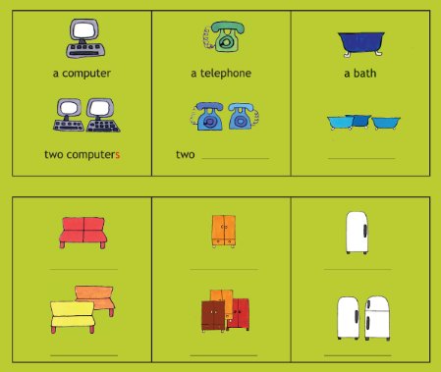
Count and write into your notebook. Preštej in zapiši v zvezek.
BOOK – p. 84 + notebook

Slide 7
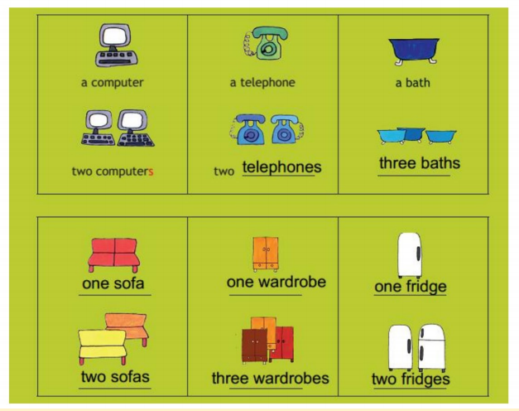
Check the answers. Preveri odgovore.
BOOK – p. 84 + notebook

Slide 8
Write a or a number into your notebook. V zvezek zapiši a ali poljubno številko.
BOOK – p. 84 + notebook

Slide 9
Check the answers. Preveri odgovore.
BOOK – p. 84 + notebook

Slide 10
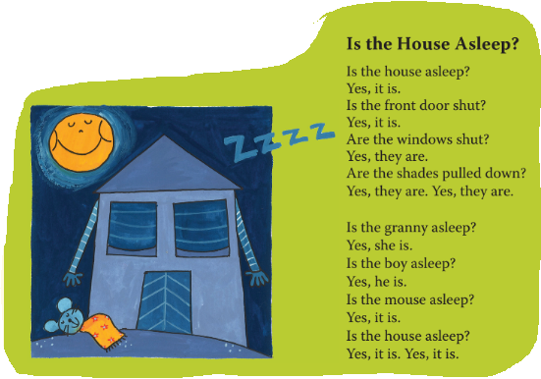
Listen and say. Poslušaj in povej.
BOOK – p. 86, exercise 18

Slide 11
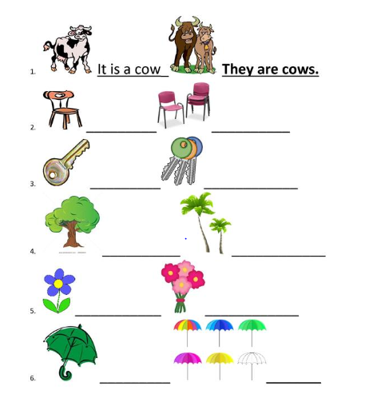
What is it? Who are they? Write into your notebook. Zapiši v zvezek.
WORKSHEET – singular, plural

Slide 12
WORKSHEET – singular, plural
Check the answers.
Preveri rešitve.
.
It is a chair.
They are chairs.
It is a key.
They are keys.
It is a tree.
They are trees.
It is a flower.
They are flowers.
______
It is an umbrella.
They are umbrellas.

Slide 13
BREAK
Play the video and do the workout. Predvajaj posnetek in telovadi.
Vir: https://wwwyoutube..com/watch?v=JoF_d5sgGgc

Slide 14
WORKBOOK – p. 82, 83
Open your workbook and do the exercises on pages 82 and 83.
Odpri delovni zvezek in naredi naloge na straneh 82 in 83.

Slide 15
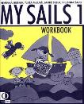
Now check the answers in your workbook.

Slide 16
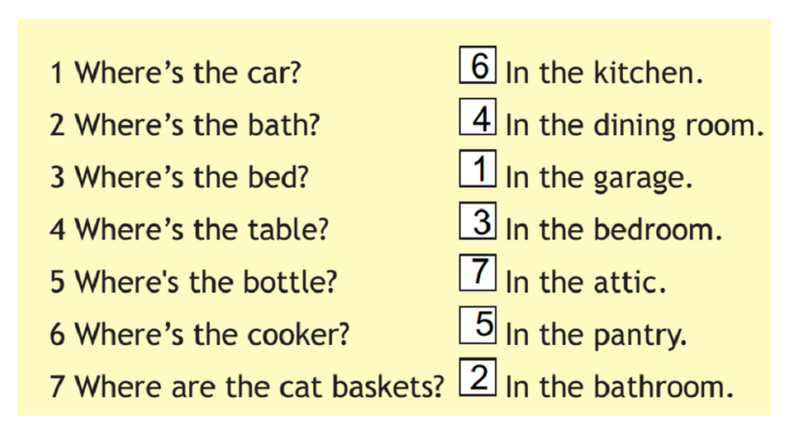
WORKBOOK – p. 82
Check the answers.
Preveri rešitve.
Stran 82, naloga 14 a

Slide 17
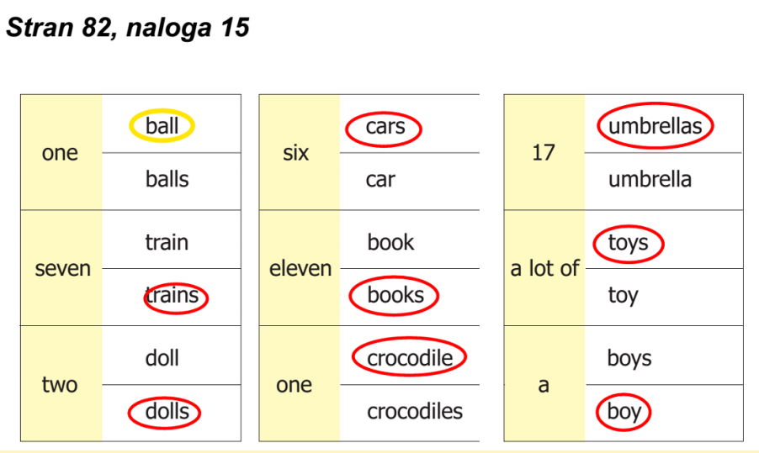
WORKBOOK – p. 82
Check the answers.
Preveri rešitve.

Slide 18
WORKBOOK – p. 83
Check the answers.
Preveri rešitve.

Slide 19
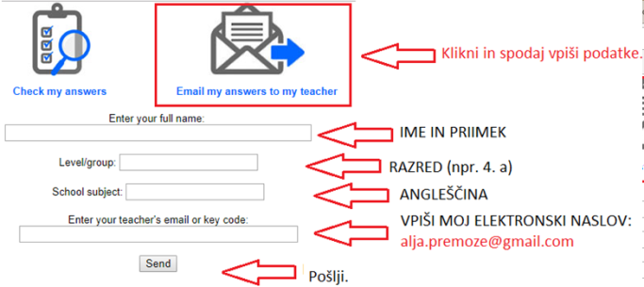
Na šolski spletni strani lahko pod gradivi za 4. razred najdeš tudi miselne izzive za TJA.
Če želiš, lahko učni list rešiš, izpolniš podatke in ga pošlješ učiteljici.
Primer vpisa podatkov:

