Slide 1
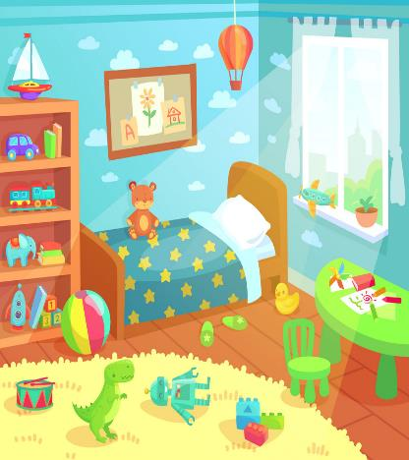
HOME UNIT 5
BOOK p. 81, 82, 83
WORKBOOK p. 78, 79, 80, 81

Slide 2
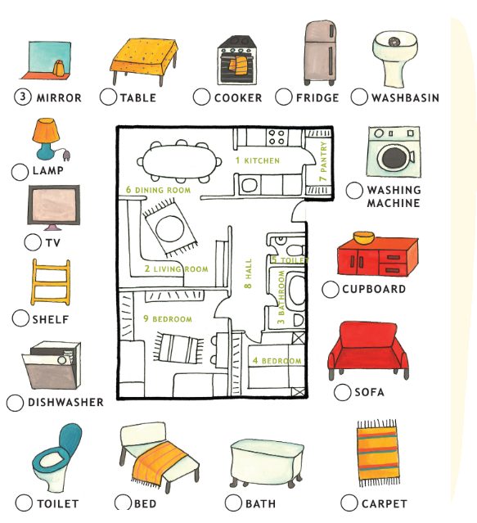
FURNITURE Listen and repeat. Poslušaj in ponovi.
BOOK – p. 81

Slide 3
Now write the words into your notebook. Sedaj prepiši besede v zvezek.
BOOK – p. 81 + notebook
FURNITURE POHIŠTVO
MIRROR – OGLEDALO
TABLE – MIZA
COOKER – ŠTEDILNIK
FRIDGE – HLADILNIK
WASHBASIN – UMIVALNIK
WASHING MACHINE – PRALNI STROJ
CUPBOARD – OMARICA
SOFA – SEDEŽNA GARNITURA
CARPET – PREPROGA
BATH – KOPALNA KAD
BED – POSTELJA
TOILET – STRANIŠČNA ŠKOLJKA
DISHWASHER – POMIVALNI STROJ
SHELF – POLICA
TV – TELEVIZIJA
LAMP – LUČ

Slide 4
FURNITURE Listen again. Match the furniture with the rooms. Write the numbers into your notebook. Ponovno poslušaj. Poveži pohištvo s prostori. Zapiši številke v zvezek.
BOOK – p. 81 + notebook

Slide 5
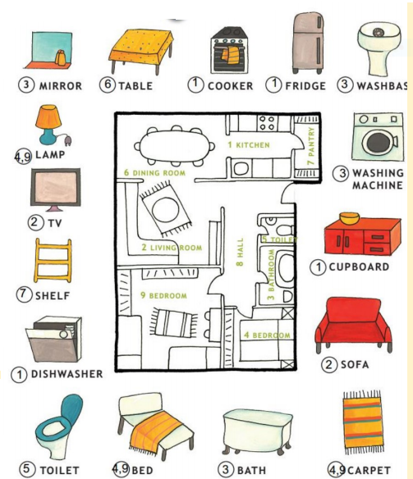
FURNITURE Check the answers. Preveri rešitve.
BOOK – p. 81 + notebook

Slide 6
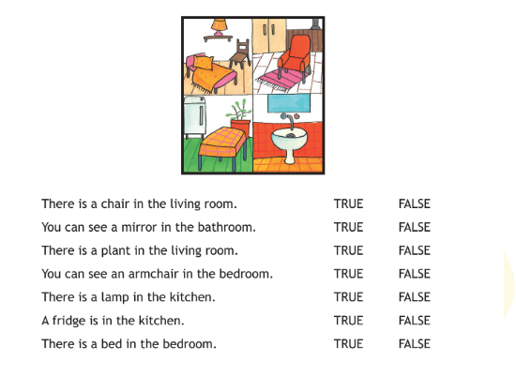
True or false. Write the sentences into your notebook. Prav ali narobe. Prepiši povedi v zvezek.
BOOK – p. 82 + notebook

Slide 7
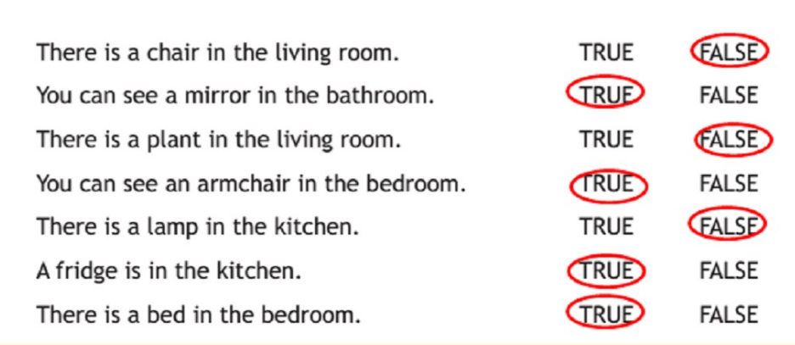
True or false. Check the answers. Prav ali narobe. Preveri rešitve.
BOOK – p. 82 + notebook

Slide 8
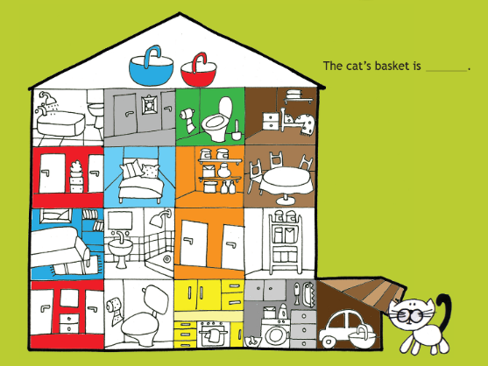
Listen and find the cat‘s basket. What colour is it? Poslušaj in najdi mucino košaro. Kakšne barve je?
BOOK – p. 83

Slide 9
Check the answer. Preveri odgovor.
BOOK – p. 83

Slide 10
BREAK
Play the video and do the workout. Predvajaj posnetek in telovadi.
Vir: https://www.youtube.com/watch?v=oc4QS2USKmk

Slide 11
WORKBOOK – p. 78, 79, 80, 81
Open your workbook and do the exercises on pages 78, 79, 80 and 81.
Odpri delovni zvezek in naredi naloge na straneh 78, 79, 80 in 81.

Slide 12
Now check the answers in your workbook.

Slide 13
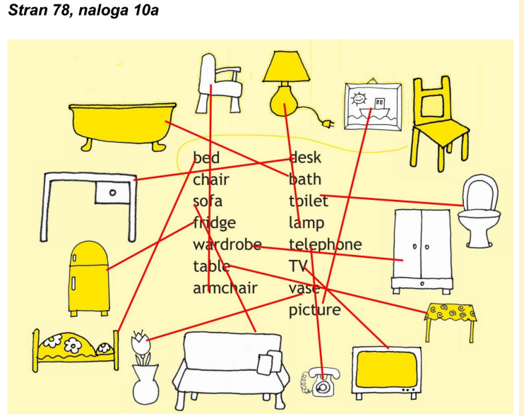
WORKBOOK – p. 78
Check the answers.
Preveri rešitve.

Slide 14
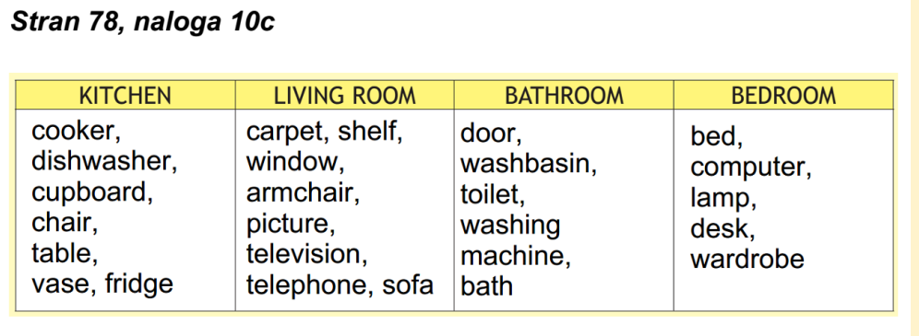
WORKBOOK – p. 78
Check the answers.
Preveri rešitve.

Slide 15
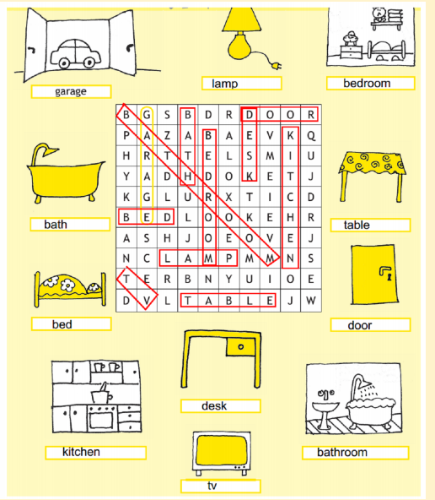
WORKBOOK – p. 79
Check the answers.
Preveri rešitve.

Slide 16
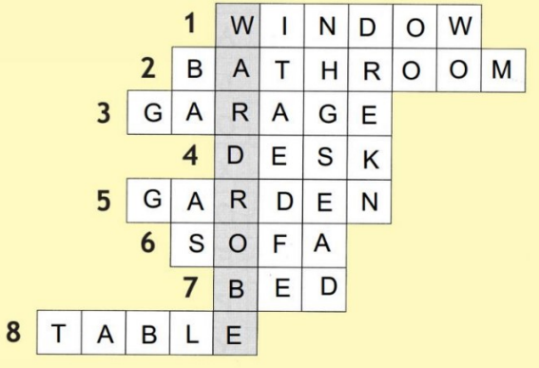
WORKBOOK – p. 80
Check the answers.
Preveri rešitve.

Slide 17
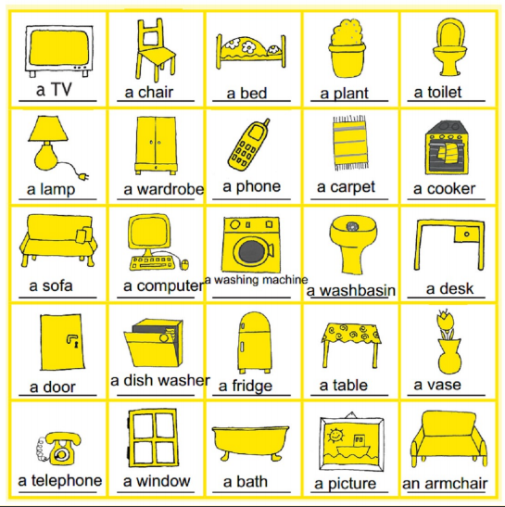
WORKBOOK – p. 81
Check the answers.
Preveri rešitve.

