Slide 1


HOME
UNIT 5
BOOK p. 78, 79, 80
WORKBOOK p. 76
WORKSHEET – VERB TO BE

Slide 2

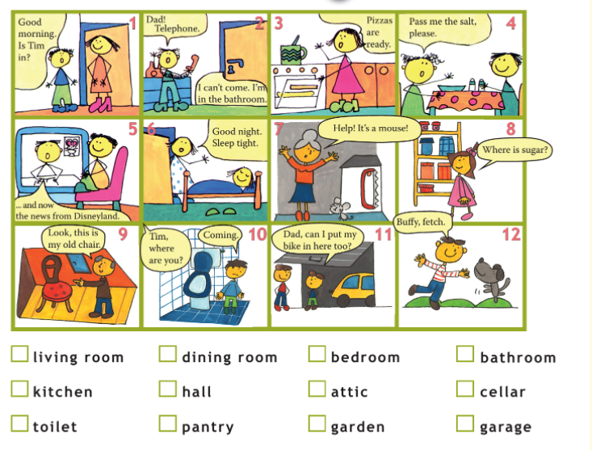
WHERE ARE THEY?
Listen and write the numbers in the notebook.
Poslušaj in napiši številke v zvezek.
BOOK – p. 78

Slide 3
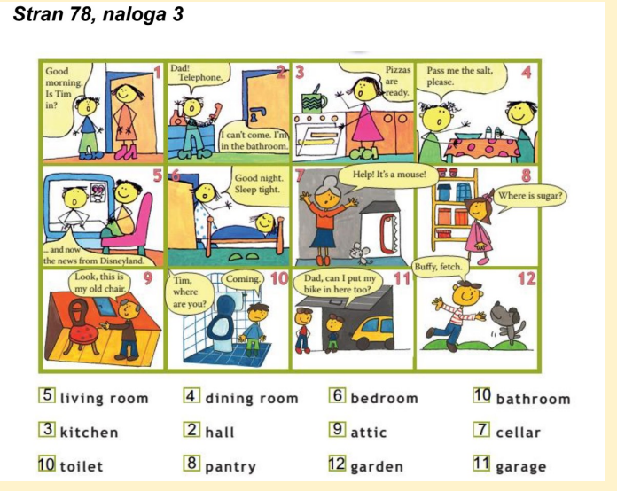
Check the numbers.
Preveri rešitve.
BOOK – p. 78

Slide 4
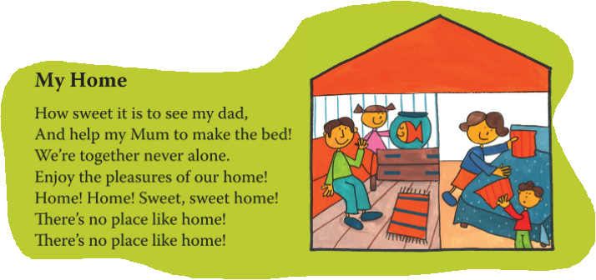
MY HOME
Listen and sing.
Poslušaj in zapoj.
BOOK – p. 78

Slide 5
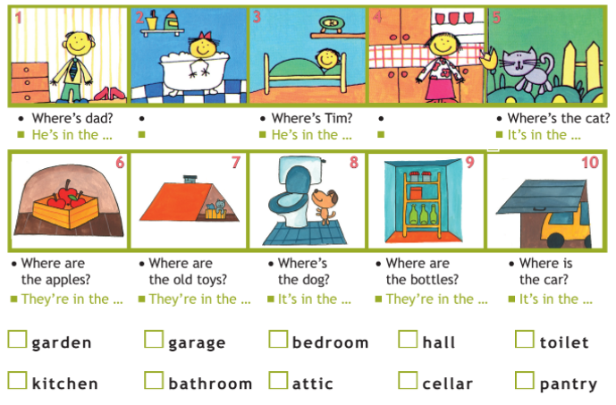
BOOK – p. 79 + NOTEBOOK
Write questions and answers into your notebook.
V zvezek napiši vprašanja in odgovore.
Where is dad?
Where‘s sister?
She‘s in the …
Where‘s mum?
She‘s in the …

Slide 6

BOOK – p. 79 + NOTEBOOK
Write questions and answers into your notebook.
V zvezek napiši vprašanja in odgovore.
Where is dad?
Where‘s sister?
She‘s in the …
Where‘s mum?
She‘s in the …

Slide 7
MY HOME book p.79
NOTEBOOK
Preveri, če imaš v zvezku pravilen zapis.
1. Where is dad?
He is in the hall.
2. Where is sister?
She is in the bathroom.
3. Where is Tim?
He is in the bedroom.
4. Where is mum?
She is in the kitchen.
5. Where is the cat?
It is in the garden.
6. Where are the apples?
They are in the cellar.
7. Where are the old toys?
They are in the attic.
8. Where is the dog?
It is in the toilet.
9. Where are the bottles?
They are in the pantry.
10. Where is the car?
It is in the garage.

Slide 8
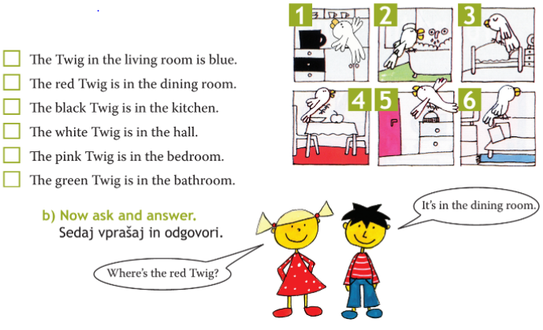
BOOK – p. 79 + NOTEBOOK
Write the sentences in your notebook and add the numbers.
Prepiši povedi v zvezek in dopolni s številkami.

Slide 9
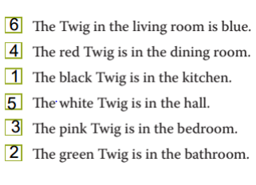
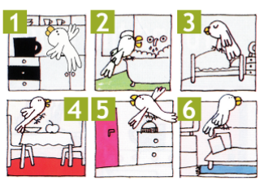
NOTEBOOK
Preveri, če imaš v zvezku pravilen zapis.
Check the answers.
Preveri rešitve.

Slide 10

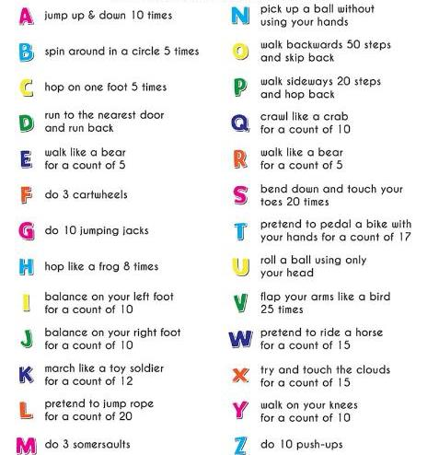

BREAK – spell your name and surname and do the activity.
Črkuj svoje ime in priimek in opravi nalogo.
10 x poskoči.
5 x se zavrti v krogu.
5 x poskoči na eni nogi.
Steci do najbližjih vrat in nazaj.
5 sekund hodi kot medved.
Naredi 3 kolesa.
Naredi 10 x
8 x poskoči kot žaba.
10 sekund stoj na levi nogi.
10 sekund stoj na desni nogi.
12 sekund korakaj kot vojak.
20 sekund se delaj, da skačeš čez vrv.
Naredi 3 prevale.
Poberi žogo brez uporabe rok,
Hodi 50 korakov nazaj in priteci nazaj.
Hodi 20 korakov v stran in priskači nazaj.
10 sekund se plazi kot rak.
5 sekund hodi kot medved.
20 x se skloni in se dotakni prstov na nogah.
17 sekund z rokami delaj, kot da voziš kolo.
Kotali žogo z glavo.
25x z rokami zamahni kot ptica.
15 sekund se delaj, da jahaš konja.
15 sekund se z rokami poskusi dotakniti oblakov.
10 sekund hodi po kolenih.
Naredi 10 sklec.

Slide 11
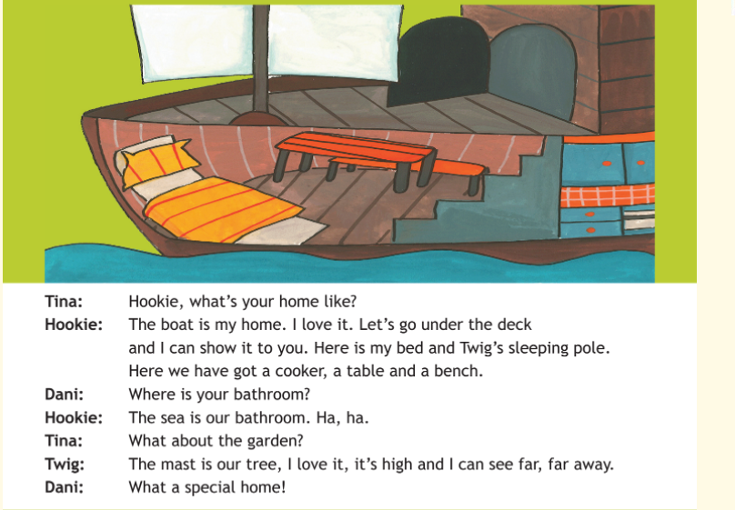
BOOK – p. 80
What‘s your home like?
Kakšen je tvoj dom?
Listen and read the text.
Vadi branje s pomočjo poslušanja posnetka.
New words:
Nove besede:
a deck – paluba
a pole – drog
a cooker – štedilnik
a table – miza
a bench – klop
a mast – jambor

Slide 12
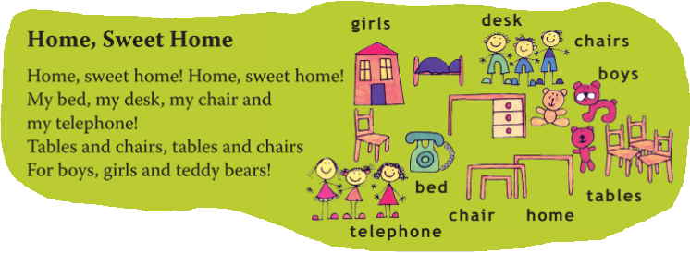
BOOK – p. 80
Home, Sweet Home
Listen and point.
Poslušaj in pokaži.

Slide 13

WORKBOOK – p. 76
Open your workbook on page 76 and do the exercise.
Odpri delovni zvezek na stani 76 in naredi nalogo.

Slide 14
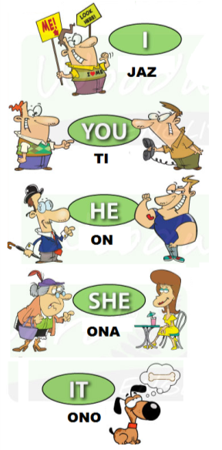
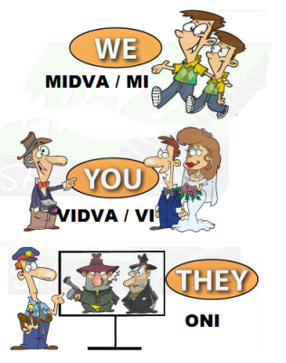
WHO?
KDO?

Slide 15
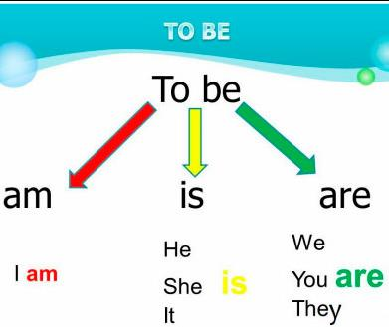
REMEMBER?
Se spomniš?
I am … Jaz sem …
He is … On je …
She is … Ona je …
It is … Ono je …
We are … Mi smo …
You are … Vi ste …
They are … Oni so …

Slide 16
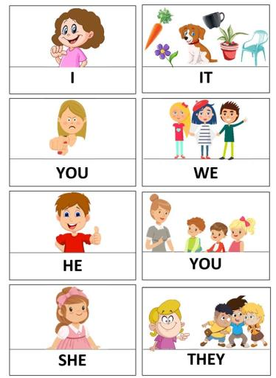
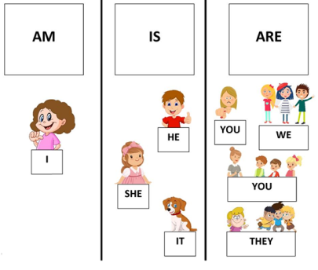

Slide 17
TO BE (BITI)
DOLG ZAPIS
KRATEK ZAPIS
I am a boy.
He is old.
She is young.
It is a dog.
We are happy.
You are tall.
They are friendly.
I‘m a boy.
He‘s old.
She‘s young.
It‘s a dog.
We‘re happy.
You‘re tall.
They‘re friendly.

Slide 18
WORKSHEET – TO BE (AM, IS, ARE)
Complete the sentences with the forms of verb TO BE (am, is, are). Dopolni povedi z ustreznimi oblikami glagola biti. 1. I ______ at home. 2. She ________ in the kitchen. 3. We ________ in the living room. 4. This ________ my photo. 5. My friends __________ at school. 6. Uncle George _____ great. 7. The dog ________ black. 8. He _______ very funny. 9. The snakes __________ dangerous. 10. You ________ fussy. 11. Susan ________ nice. 12. They ___________ in the house. 13. This PC game ________ cool. 14. My brother ________ very tall. 15. They _________ in Italy.

Slide 19
REŠITVE WORKSHEET – TO BE (AM, IS, ARE)
Preveri, če imaš v zvezku pravilen zapis.
TO BE 1. I am at home. 2. She is in the kitchen. 3. We are in the living room. 4. This is my photo. 5. My friends are at school. 6. Uncle George is great. 7. The dog is black. 8. He is very funny. 9. The snakes are dangerous. 10. You are fussy. 11. Susan is nice. 12. They are in the house. 13. This PC game is cool. 14. My brother is very tall. 15. They are in Italy.

Slide 20


Now check the answers in your workbook!

Slide 21
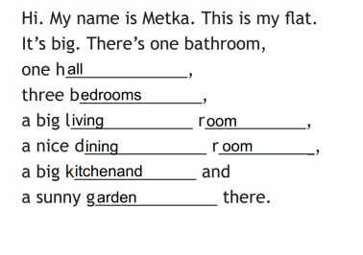
WORKBOOK – p. 76
Check the answers.
Preveri rešitve.

