Slide 1
HOME UNIT 5
BOOK p. 76, 77
WORKBOOK p. 72–75

Slide 2
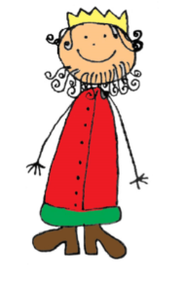
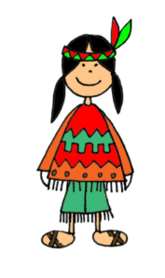
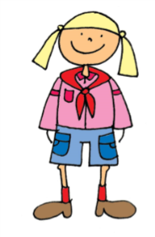
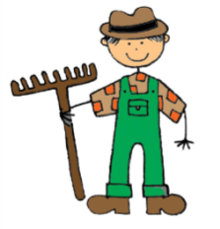
HELLO!
DO YOU KNOW WHO I AM?
LET‘S MEET!

Slide 3
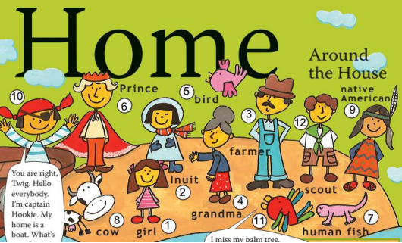
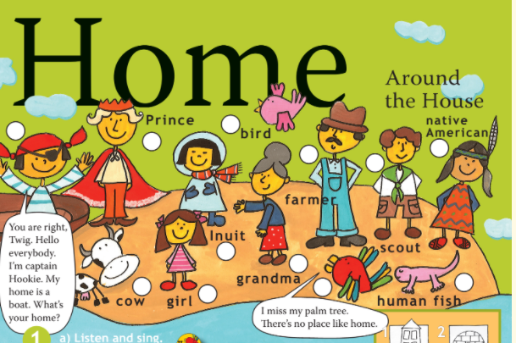
Listen and write the numbers. (Poslušaj in napiši številke.)
BOOK – p. 76

Slide 4
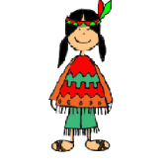
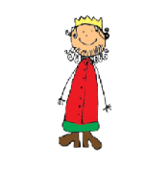
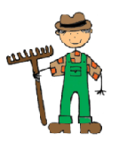
WHO AM I? (Kdo sem jaz?)
a human fish
(človeška ribica)
a native American
(Indijanec)
an Inuit
(Eskim)
a scout
(skavtinja)
a prince
(princ)
a farmer
(kmetovalec)

Slide 5
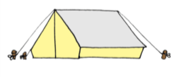
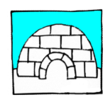
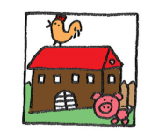
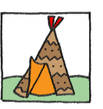
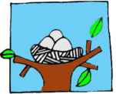
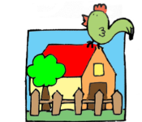
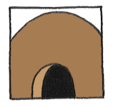
DO YOU KNOW WHERE I LIVE?
LET‘S FIND OUT!

Slide 6
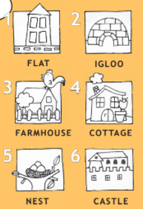
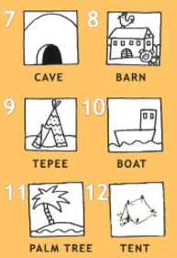
Listen and repeat. (Poslušaj in ponovi.)

Slide 7
HOMES
A FARMHOUSE – kmetija
AN IGLOO – iglu
A TENT – šotor
A COTTAGE – koča/hiša
A CASTLE – grad
A NEST – gnezdo
A BARN – skedenj
A CAVE – jama
A BOAT / A SHIP – ladja
A TEPEE – indijanski šotor
A FLAT – stanovanje
A PALM TREE – drevo palme

Slide 8
Listen. (Poslušaj.)
BOOK – p. 76
1
2
3
4
5
6
7
8
9
10
11
12

Slide 9
WHAT‘S YOUR HOME?
Fill the sentences. (Dopolni povedi.)
A PRINCE lives in a ______________.
A PARROT lives in a ______________.
A FARMER lives in a ______________.
A PIRATE lives in a ______________.
AN INUIT lives in an ______________.
A HUMAN FISH lives in a ______________.
A NATIVE AMERICAN lives in a ______________.
A SCOUT sleeps in a ______________.
A COW lives in a ______________.
A BIRD lives in a ______________.
Ben‘s GRANDMA lives in a ______________.
This BOY lives in a ______________.

Slide 10
NOTEBOOK
WRITE IN YOUR NOTEBOOK. (ZAPIŠI V ZVEZEK.)
WHAT‘S YOUR HOME?
A prince lives in a CASTLE.
A parrot lives in a PALM TREE.
A farmer lives in a FARMHOUSE.
A pirate lives in a BOAT.
An Inuit lives in an IGLOO.
A human fish lives in a CAVE.
A native American lives in a TEPEE.
A scout sleeps in a TENT.
A cow lives in a BARN.
A bird lives in a NEST.
Ben‘s grandma lives in a HOUSE.
This boy lives in a FLAT.

Slide 11
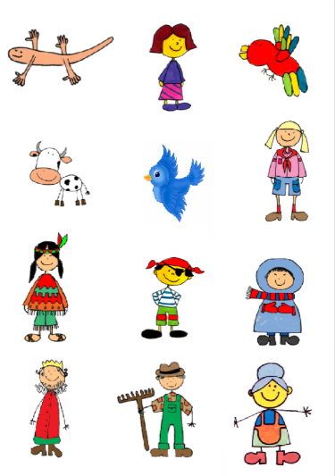
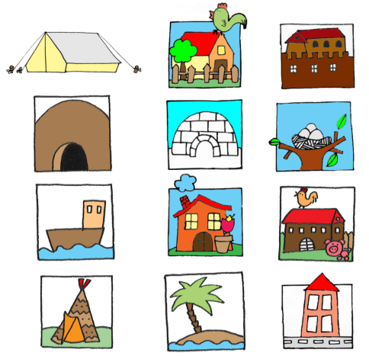
Listen again and say. (Poslušaj še enkrat in povej.)

Slide 12
WORKBOOK – p. 72, 73
Open your workbook at page 72.
(Odpri delovni zvezek na stani 72.)
Do the exercises on pages 72, 73.
(Reši naloge na straneh 72, 73.)

Slide 13
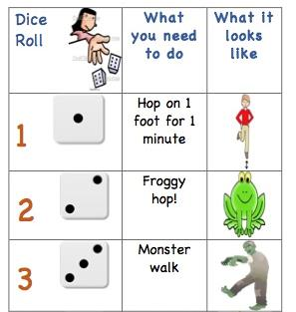
BREAK!!!

Slide 14
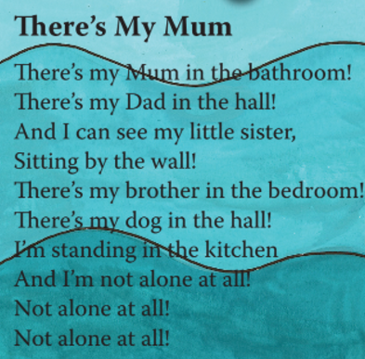
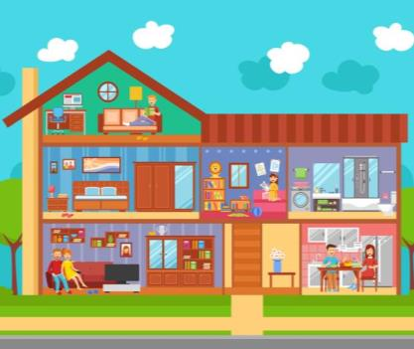
AROUND THE HOUSE
BOOK – p. 76
LISTEN AND SING. (Poslušaj in zapoj.)

Slide 15
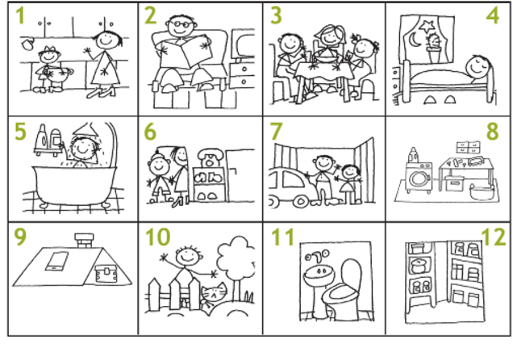
ROOMS AROUND THE HOUSE
LISTEN ADN REPEAT. (Poslušaj in ponovi.)

Slide 16
ROOMS AROUND THE HOUSE
NOTEBOOK
WRITE IN YOUR NOTEBOOK. (ZAPIŠI V ZVEZEK.)
KITCHEN – kuhinja
LIVING ROOM – dnevna soba
BATHROOM – kopalnica
HALL – hodnik
PANTRY – shramba
TOILET/WC – stranišče
DINING ROOM – jedilnica
BEDROOM – spalnica
GARAGE – garaža
CELLAR – klet
ATTIC – podstrešje
GARDEN – vrt

Slide 17
LISTEN AND WRITE THE NUMBERS. (Poslušaj in napiši številke.)
BOOK – p. 77
GARAGE
GARDEN
ATTIC
CELLAR
TOILET (WC)
PANTRY
7. GARAGE
10. GARDEN
9. ATTIC
8. CELLAR
11. TOILET (WC)
12. PANTRY
1. KITCHEN
6. HALL
3. DINING ROOM
2. LIVING ROOM
5. BATHROOM
4. BEDROOM
KITCHEN
HALL
DINING ROOM
LIVING ROOM
BATHROOM
BEDROOM

Slide 18
Listen and choose the correct picture. Where are they? (Poslušaj in izberi pravo sliko. Kje so?)
BOOK – p. 77
1.
2.
3.
4.

Slide 19
WORKBOOK – p. 74, 75
Open your workbook at page 74.
(Odpri delovni zvezek na stani 74.)
Do the exercises on pages 74, 75.
(Reši naloge na straneh 74, 75.)

Slide 20
Now check the answers in your workbook!

Slide 21
OPOMNIK!
Kadar imate pri TJA datumsko določen rok oddaje izdelka, ga morate poslati svoji učiteljici angleščine:
4. A, 4. C, 4. D -> ge. Karmen J. Mlinarič (karmen.mlinaric@guest.arnes.si)
4. B -> ge. Alji Premože
(alja.premoze@gmail.com)
Zapisov vaših zvezkih in reševanja nalog v delovnih zvezkih nama ni potrebno pošiljati, razen, če to posebej zahtevava. Rešitve nalog so vedno dodane gradivom.

Slide 22
REŠITVE

Slide 23
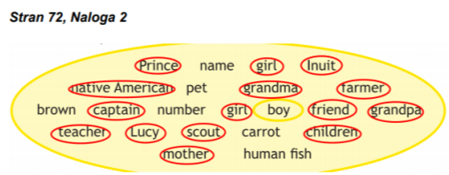
REŠITVE

Slide 24
REŠITVE

Slide 25
REŠITVE

