Slide 1
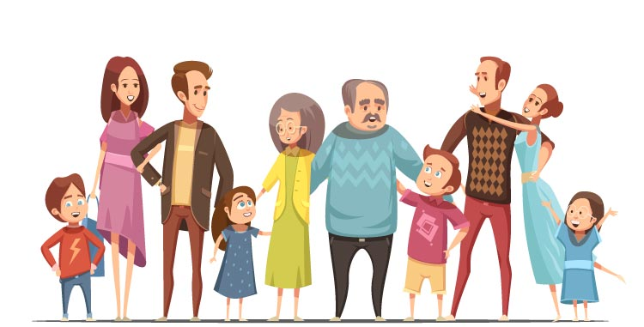
MEET MY FAMILY unit 4
Book page 58–75
Workbook page 54–71

Slide 2
Ask and answer. Use „Whose … is this?“ (Vprašaj in odgovori. Uporabi „Whose … is this?“)
REVISION - ponovitev
Whose fish is this?
This is Hookie‘s fish.
Whose ball is this?
This is Tina‘s ball.
Whose bike is this?
This is David‘s bike.
Whose parrot is this?
This is John‘s parrot.
Whose doll is this?
This is mum‘s doll.
Whose dog is this?
This is Bob‘s dog.

Slide 3
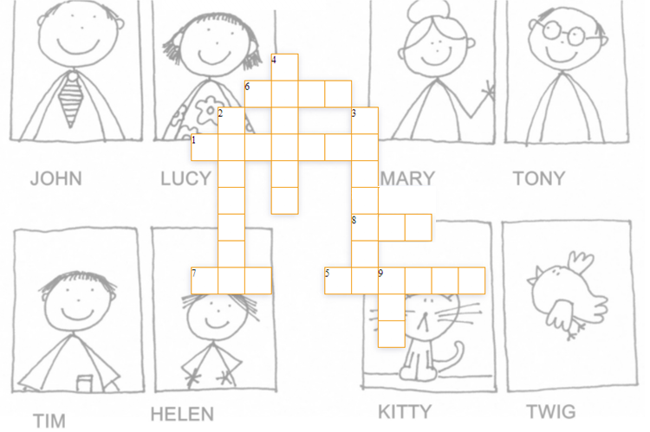
REVISION - ponovitev
Solve the crossword.
Start with words „across“.
Reši križanko.
Začni z besedami „vodoravno“.
S
S
E
R
B I R D
G
A
N
D
P
G
A
N
M
B R O T H E R
D A D
C A T
F A M I L Y
U
M

Slide 4
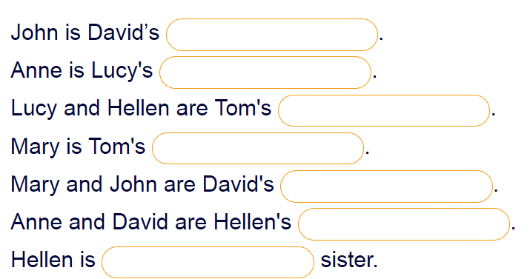
Who is who? (Kdo je kdo.)
REVISION - ponovitev
dad
mum
sisters
grandma
parents
parents
Lucy‘s

Slide 5
REVISION - ponovitev
Can you find the words on the right in the word square?
Look in different directions.
Ali lahko najdeš besede na desni v besednem kvadratu?
Iščeš lahko v različnih smereh.

Slide 6
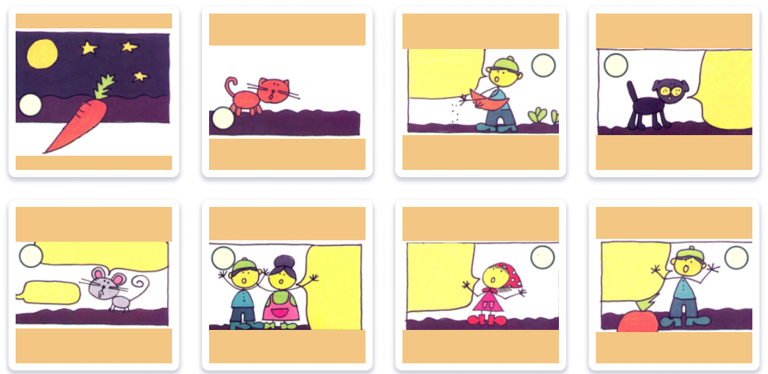
REVISION - ponovitev
THE ENORMOUS CARROT
Put picture in the correct order.
(Postavi slike v pravilni vrstni red.)
1. 2. 3. 4. 5. 6. 7. 8.

Slide 7
WORKBOOK – p. 69, 70, 71
Finish the exercises in your workbook (page 69, 70, 71).
Če ti še ni uspelo, dokončaj naloge v delovnem zvezku (str. 69, 70, 71).

Slide 8
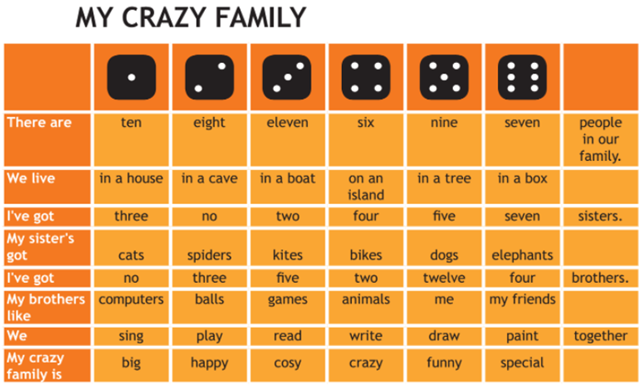
Throw a dice and write the sentences in your notebook.
(Vrzi kocko in povedi napiši v zvezek.)
Example (primer):
1. There are eight people in our family.
2. We live in a tree.
3. I‘ve got seven sisters.

Slide 9
NOTEBOOK
Open your book at page 73. (Odpri knjigo na stani 73.)
Write the title CHATERBOOX – FAMILY in your notebook. (V zvezek napiši naslov CHATERBOOX – FAMILY.)
Match and write the sentences.
(Poveži oblačke in povedi prepiši v zvezek).
EXAMPLE (primer):
A: Who is this?
B: This is Tim‘s mum.
A: What‘s your dad‘s name?
B: My dad‘s name is Tone.

Slide 10
CHATERBOX – FAMILY
Now listen and check.

Slide 11
Now do the revision of unit 4!
There is another file on school page.
Send the picture (or scan) of your work to your teacher until 20. 4. 2020.
Odlično! Zdaj pa reši preverjanje znanja. Datoteko najdeš na šolski spletni strani.
Fotografijo ali „scan“ pošlji svoji učiteljici do 20. 4. 2020.

